Slide 1
Warm up 2: August 31st
1. What landmarks or places have you visited in North Carolina? Which was your favorite, why?
2. Describe how you learn social studies best? What type of activities or work help you understand concepts in history?

Slide 2
North Carolina
1-3 Famous Historical Landmarks

Slide 3
Carowinds
Carowinds – A theme park sharing a border of North Carolina and South Carolina, Carowinds has been open since 1973. The theme park has roller coasters and kids rides, as well as a kid park. Each fall it is open as “Scarowinds”, meant to for Halloween and is open at night, greatly increasing visitors.
Fun fact: Carowinds was built intentionally on the border of both states to bring the two states together, as they have been quite competitive with each other in the past.

Slide 4
Mount Mitchell
Mount Mitchell - Part of the Appalachian range, this mountain lies about 30 mostly north of Asheville. Mount Mitchell sees an average of 90 inches of snow a year, which is 80 more than we average in Charlotte, but it is a mile higher in altitude. The top is easily accessible by car, though there is great hiking in the area.
Fun fact: Mount Mitchell is the highest peak east of the Mississippi River, standing at an amazing 6, 684 feet! (Charlotte is at 770 or so.)

Slide 5
Tweetsie Railroad
Tweetsie Railroad – Situated just north of Blowing Rock and south of Boone, this kid aged theme park is a major attraction in the North Carolina mountains. This “Wild-West” theme park also has a petting farm, arcade, and three mile ride with a cowboys and Indians shootout.
Fun fact: The train is an actual steam locomotive engine

Slide 6
Chimney Rock
Chimney Rock – Located South of Asheville and only about 1 ½ hours from here, this state park offers beautiful views of the Blue Ridge Mountains. Famous Native-American movie The Last of the Mohicans had many of its most memorable scenes filmed near here. It didn’t become part of the North Carolina State Parks system until 2005, oddly.
Fun Fact: The stairway was built in 1885, and there are an elevator and tunnel leading to the summit (top).

Slide 7
Sliding Rock
Sliding Rock - Literally a slide that you can travel down, Sliding Rock waterfall travels 60 feet down the Looking Glass Creek into 7 foot pool at the end of the falls. This is only about an hour and a half away from the LKN area.
Fun fact: It costs $2.00 per person to go down the slide, but I’m sure it’s worth it.

Slide 8
Hanging Rock
Hanging Rock – A popular destination only 1 ½ hours north of here, this beautiful mountain top is near the border of NC and Virginia, 30 miles north of Winston-Salem. The park is actually free (tax dollars at work!), and very popular with families since there are quality facilities and a lake, as well as easier to climb than other area mountains. It is part of the Mountains-To-Sea-Trail, connecting what you can guess, the mountains to the ocean in NC.
Fun fact: Copperheads and timber rattlesnakes live in the park, but won’t mess with you unless you mess with them, and you don’t want to.

Slide 9
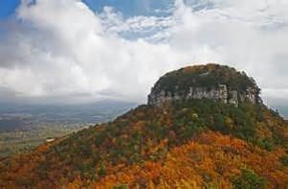
Pilot Mountain
Pilot Mountain – The very iconic and visible mountaintop north of Winston-Salem (you can see it traveling on I-77), was known as the “Great Guide” by local Native Americans. This very easy to climb park is again only about 1 ½ hours from here, and you can mostly drive up to the top. The mountain was used as a refuge or safe haven for many hiding from other groups during fighting.
Fun fact: The town of Pilot Mountain was believed to be the fictional basis of the really old TV show, The Andy Griffith Show, just ask your grandparents…

Slide 10
Lake Norman
Lake Norman (LKN) – That’s not supposed to look too familiar, but this is part of Lake Norman, believed to be past Jetton Park and the “Peninsula” area. Built and dammed from the Catawba River and finished in 1964, LKN was built by Duke Energy, who had a keen business sense in mind. LKN is the largest manmade body of fresh water in the state.
Fun fact: LKN has 520 miles of coast line, which is the same distance to drive from Charlotte to Cleveland, OH, or down to Orlando, FL.

Slide 11
North Carolina State Zoological Park
North Carolina State Zoo - Located pretty centrally in our state, the NC State Zoo is in Asheboro, and about 1 ½ hours from here. The zoo has two parts, “North America”, and “Africa” as the more exotic animals would be in the African section. The NC Zoo has the largest collection of chimpanzees in the country, and is only closed one day a year.
Fun fact: Following the invasion of Afghanistan in 2001, the NC Zoo led the effort to rebuild and maintain the zoo in Kabul, a main city there.

Slide 12
Pinehurst
Pinehurst Golf Club – The upscale private golf club located in the center of the state has been the home of 3 U.S. Opens. There are two main courses, but it is also home to croquet and lawn bowling (what is that???). It’s definitely a “who’s who” place to be.
Fun fact: The lowest membership to join is $16,000, or about how much a year’s tuitions is at UNC public colleges.

Slide 13
Grandfather Mountain
Grandfather Mountain – About 2 ½ hours away along the Blue Ridge Parkway, Grandfather Mountain is near Linville and is pretty amazing (hard to argue). With an iconic mile-high swinging bridge, this is easily one of the state’s most popular visitation destinations. There is ample hiking, a visitor’s center, small animal habitat, and some of the best views east of the Rockies.
Fun facts: Wind speeds of 200 mph have been recorded in the area, believed to be some of the fastest EVER recorded.
Charlotte is visible on the clearest of days (more than likely in the fall.)
A famous scene in Forrest Gump was filmed on the curvy entrance to the top.

Slide 14
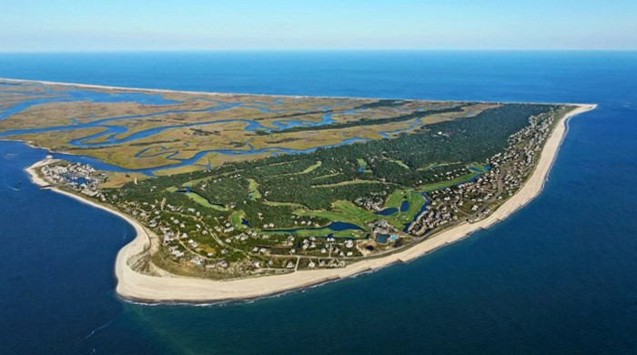
Cape Fear River
Cape Fear River – Carving out one of North Carolina’s best cities to visit, Wilmington, the Cape Fear River begins near Greensboro (Haw River), and meanders for 202 miles, dumping out into the Atlantic Ocean. The river has been used for centuries for a mode of transportation, and is the largest river basin in the state.
Fun fact: Wilmington is the center of many movie shoots, mostly for its proximity to the picturesque river.

Slide 15
Bentonville Battlefield
Bentonville Battlefield – The battle was the last full-scale action of the Civil War in which a Confederate (Southern) army was able to mount a tactical offensive (victory). The largest ever battle fought in NC, was the only attempt to defeat the Union and marauding general William Sherman on his destruction of the South.
Fun fact: The three day battle saw the Confederacy defeat the Union, though they were outnumbered 3:1 (60K to 20K).

Slide 16
Fort Bragg
Fort Bragg – Established in 1918 near Fayetteville, Fort Bragg is home to one of the largest military bases in the country. Home to U.S. Army Airborne and Special Forces, Fort Bragg was originally constructed for World War 1, and named after a famous Confederate General in the Civil War, Braxton Bragg.
Fun Fact: With a normal population of 5,400, during World War II the camp’s population swelled to 159,000 as it served as a main training site.

Slide 17
Bank of America Stadium
Bank of America Stadium – Home to the NFL’s Carolina Panthers (notice Carolina, not Charlotte…), opened in 1996 and recently underwent major renovations and the construction of a new scoreboard and escalators. Also used for mostly college football games, the stadium rarely sees concerts there, rare for a football stadium. The Panthers played their first season in 1995 three hours away in Clemson, SC.
Fun fact: The 2012 Democratic National Convention was supposed to have its final event there, the nomination of Barack Obama, but was moved indoors due to the threat of thunderstorms. It never even got that cloudy…

Slide 18
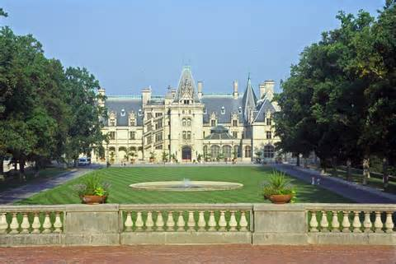
Biltmore Estate
Biltmore House – Located in Asheville, the majestic estate built by George Vanderbilt, it was once the largest privately owned home in the country A massive tourist attraction for people all over the country, the Biltmore Estate also has pristine gardens, has been the location for many high-profile gardens, and is widely regarded as one of the most beautiful homes in America.
Fun fact: During World War II many paintings and sculptures were moved from Washington, D.C., to the Biltmore for safe keeping.

Slide 19
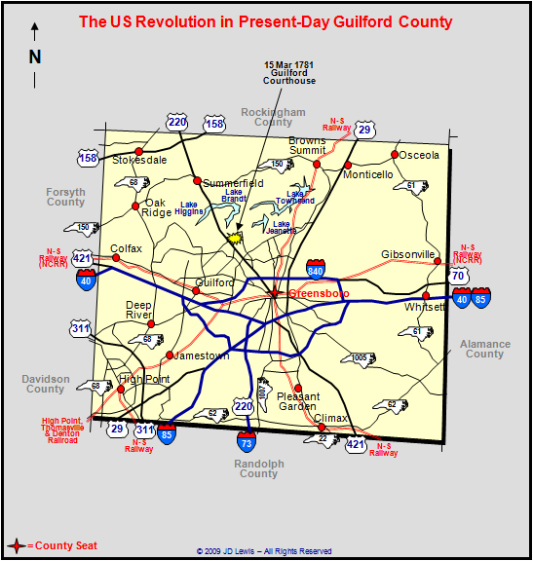
Guilford Courthouse
Battle of Guilford Courthouse – Just over an hour away near Greensboro, this massive one day battle of the Revolutionary War was a turning point to “American” victory against the British in 1781. Though the Americans “lost” the battle, the heavy number of British casualties was a win for the Americans fighting for independence. The movie The Patriot portrays this battle towards the end, as of the most epic encounters of the war.
Fun fact: Every year, on or around March 15, the date of the battle, a re-enactment occurs of the battle.

Slide 20
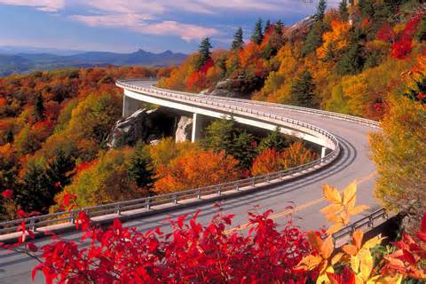
Blue Ridge Parkway
Blue Ridge Parkway – A national parkway dubbed “America’s Finest Drive” travels for almost 500 miles of North Carolina and Virginia. Known for its beauty as it traverses through the Appalachian Mountains, the parkway is most often visited in the fall, as you can see why to the left. Traffic is very heavy along the parkway, and you can access it very easily.
Fun fact: Though it’s not a national park, it’s been the most visited unit of the park system for every year the last 65 years!
FYI, if you think living in North Carolina is boring, I’m sorry!

Slide 21
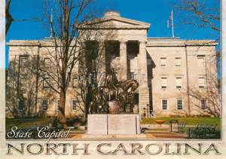
Raleigh
State Capitol – In Raleigh (you all knew that), the capitol building was complete in 1840 after 7 years of construction. It’s fairly bland, but the greenish copper top of the dome is fairly well known.
Fun fact: It replaced a building destroyed by fire in 1831, as there wasn’t really a capitol building.

Slide 22
Tryon Palace
Tryon Palace – Named for a British soldier, William Tryon, it served as his base of him being governor of NC (province) from 1765-1771. A fire ruined the majority of the home in New Bern, along the coast, though much was rebuilt.
Fun fact: Tryon left NC in 1771 to become governor of NY, only living in the house for just over a year.

Slide 23
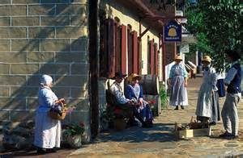
Old Salem
Old Salem - Located in Winston-Salem just an hour away, this one-time true Moravian Village is now the home to a look at how life used to be. A National Historic Landmark, Old Salem was home to many from the area of what is now the Czech Republic. You can visit for a true representation of the simplicity of life from the mid-1700s.
Fun fact: Italian sports car maker Fiat filmed a well-known commercial at Old Salem in April 2013.

Slide 24
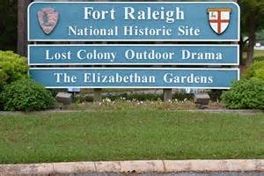
Fort Raleigh
Fort Raleigh - Home to what is known to be the first English settlement in the United States, this fort rich in history and mystery is along the edge of the Outer Banks near the town of Manteo. Today there are historic gardens, the Elizabethan Gardens, as well as an outdoor theater. It is most definitely a National Historic Site.
Fun Fact: This is the home of the “Lost Colony”, as original settlers from John White’s colony disappeared, as well as Virginia Dare, the first English person born on American soil.

Slide 25
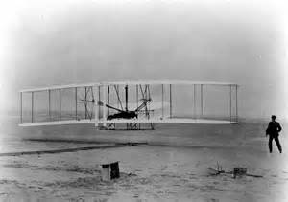
Kitty Hawk
Kitty Hawk – On the Outer Banks occurred quite possibly the most substantial event in the world of travel, flight. Orville and Wilbur Wright moved to the NC coast from Dayton, OH, to try their hands at being the first to fly. It was believe the wind on the coast was a reason for choosing North Carolina.
Fun Fact: The first flight actually occurred in Kill Devil Hills, but it didn’t exist in 1903, thus Kitty Hawk earning credit.

Slide 26
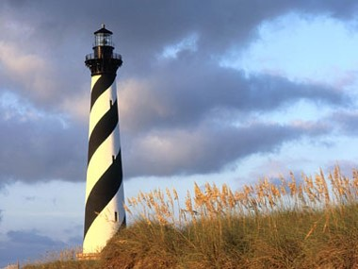
Cape Hatteras Lighthouse
Cape Hatteras Lighthouse – Possibly the most iconic landmark on the Atlantic coast, this lighthouse built in 1802 was made in an effort to help those navigating the rough coast off North Carolina’s Outer Banks, known as the “Graveyard of the Atlantic”. Destroyed from a heavy storm, in 1879 a new lighthouse was built, standing at 208 feet tall, the tallest lighthouse in the country.
Fun facts: There are 268 steps, entrance fee is $8, and you can see about 25 miles out on a clear day across the ocean.

Slide 27
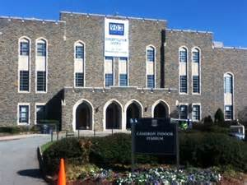
Cameron Indoor Stadium
Cameron Indoor Stadium – Located on the almost gothic-like campus of Duke University in Durham, this college basketball mecca has a storied past. Known to be absurdly hot at all times, the louder than imagined basketball “stadium” finally got air conditioning in 2002! Tickets are very hard to come by, and students camp out in “Krzyzewskiville” for weeks for bigger games.
Fun fact: Cameron Indoor only seats 9,314, about 13,000 less than UNC’s “Dean Dome”.

Slide 28
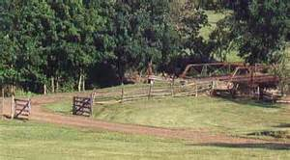
Battle of Moore’s Creek Bridge
Battle of Moore’s Creek Bridge – This event in the very eastern part of NC signaled the end of the British reign in our state. This brief battle near Wilmington strengthened the Patriots cause to break away from the strong hand ways of British rule. A sneaky barrage by Americans desiring freedom shortly before sunrise caught the Brits off guard, using the bridge as a location to throw off the British.
Fun Fact: Loyalists not only deterred the Brits from gaining more strength in NC, but only had one soldier killed and another injured.

Slide 29
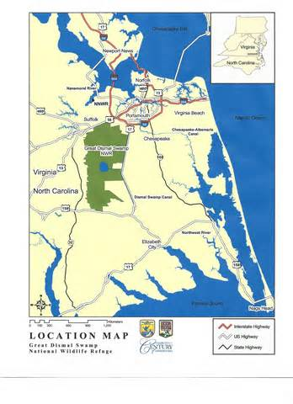
Great Dismal Swamp
Great Dismal Swamp – Bordering NC and Virginia, this swamp is very rare for this part of the country. From Native Americans to runaway slaves, the swamp was a haven for those looking to avoid the evils of the world. The swamp today isn’t very recreational, due to efforts to preserve its sanctity and beauty.
Fun Fact: A canal was built by NC and Virginia in 1805 for the harvesting of timber, and is the oldest operating artificial waterway in the United States.

Slide 30
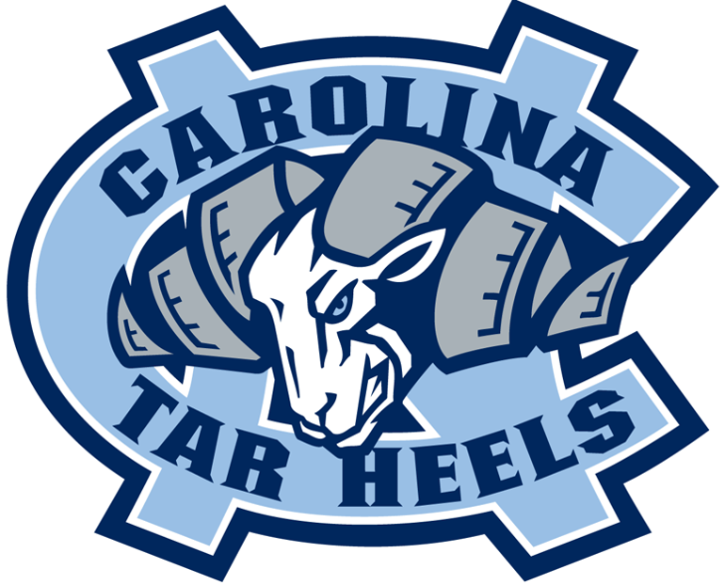
UNC Chapel-Hill
UNC Chapel-Hill – The first public college in the state, UNC Chapel-Hill is home to the famous Tar Heels, and anchors one of six UNC system schools (Asheville, Charlotte, Greensboro, Pembroke, Wilmington). Known for it’s beautiful campus and famous alumni, UNC is a top destination for scholars globally.

Slide 31
Lake Mattamuskeet
Lake Mattamuskeet – This extremely shallow lake, as seen in the pictures beside, is quite small. Located near the coast and the Pamlico Sound, the lake is a winter home to many larger birds looking for warmer water due to its shallowness.
Fun Fact: Lake Mattamuskeet is the largest natural lake in the state.

Slide 32
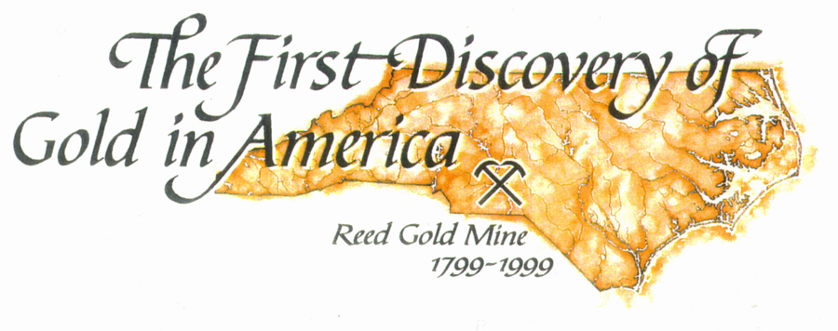
Reed Gold Mine
Reed Gold Mine – Only about 45 minutes away past Concord, this gold mine is the first documented find of gold in the country. The first gold found I the Little Meadow Creek weighed 17 pounds and was bought for $3.50, when in reality the value back then in 1799 was $3,600!
Fun Fact: The 17 pound gold nugget was used for three years as a door stop.

Slide 33
Edward Teach Home
Edward Teach Home – Commonly known as Blackbeard, the most infamous of all pirates on the coast, Teach had an impact on the Carolinas, though smaller in NC. Always a target due to his horrible tactics and penchant to cause trouble on the sea disrupting trade and commerce, Blackbeard was killed by Virginia governor Alexander Spotswood in 1718.
Fun Fact: He was famous for marooning a crew he thought may be rebellious, once leaving 25 men behind on a small island off the coast of NC.

Slide 34
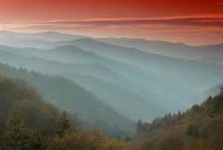
Great Smokey Mountains
Great Smoky Mountains – Bordering Tennessee and NC, but more famously in Tennessee, these mountains get their name from the natural fog that often times begins each day in the mountains. Home to many types of very wild animals, the mountains capitalize off their beauty with an ample amount of tourism and commercial aspects.
Fun Fact: It is the most visited national park in the country, with over 9 million visitors a year! That’s roughly the population of NC.

Slide 35
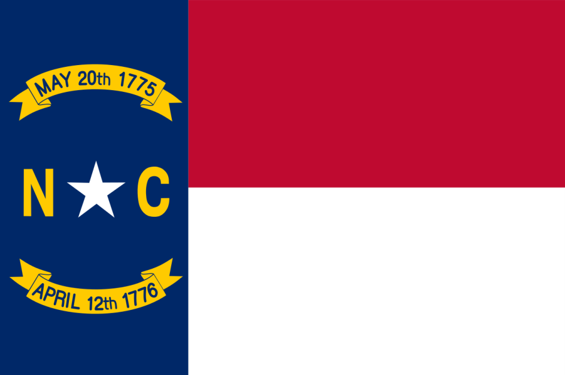
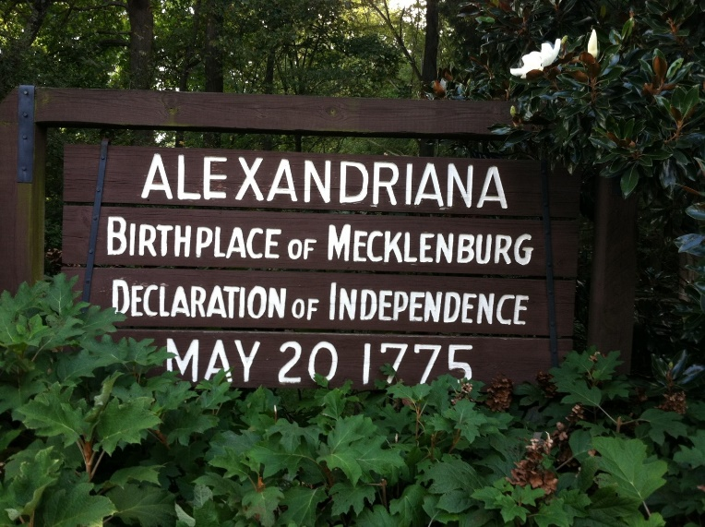
Alexandriana Park
The Mecklenburg Declaration of Independence is claimed by some to be the first declaration of independence made in the Thirteen Colonies during the American Revolution. It was supposedly signed on May 20, 1775, at Charlotte, North Carolina, by a committee of citizens of Mecklenburg County, who declared independence from Great Britain after hearing of the battle of Lexington. If the story is true, the Mecklenburg Declaration preceded the United States Declaration of Independence by more than a year. The authenticity of the Mecklenburg Declaration has been disputed since it was first published in 1819, forty-four years after it was reputedly written. There is no conclusive evidence to confirm the original document's existence, and no reference to it has been found in extant newspapers from 1775.
Fun Fact- supposedly written and signed right down the street!!!

Slide 36
USNWC
U.S. National Whitewater Center (USNWC)
A manmade whitewater channel, high ropes courses, ziplines, paddle boarding and more! They do weekly concerts and admission is free. You only pay to do the courses but the trails and concerts are free! And it is here in Charlotte!
Fun Fact: The pumps for the whitewater channel move a half million gallons per minute when they are all running at full.

