Slide 1
Warm Up
What are the major causes of WWII?
What is America’s stance for WWII?
1) Warm Up!

Slide 2
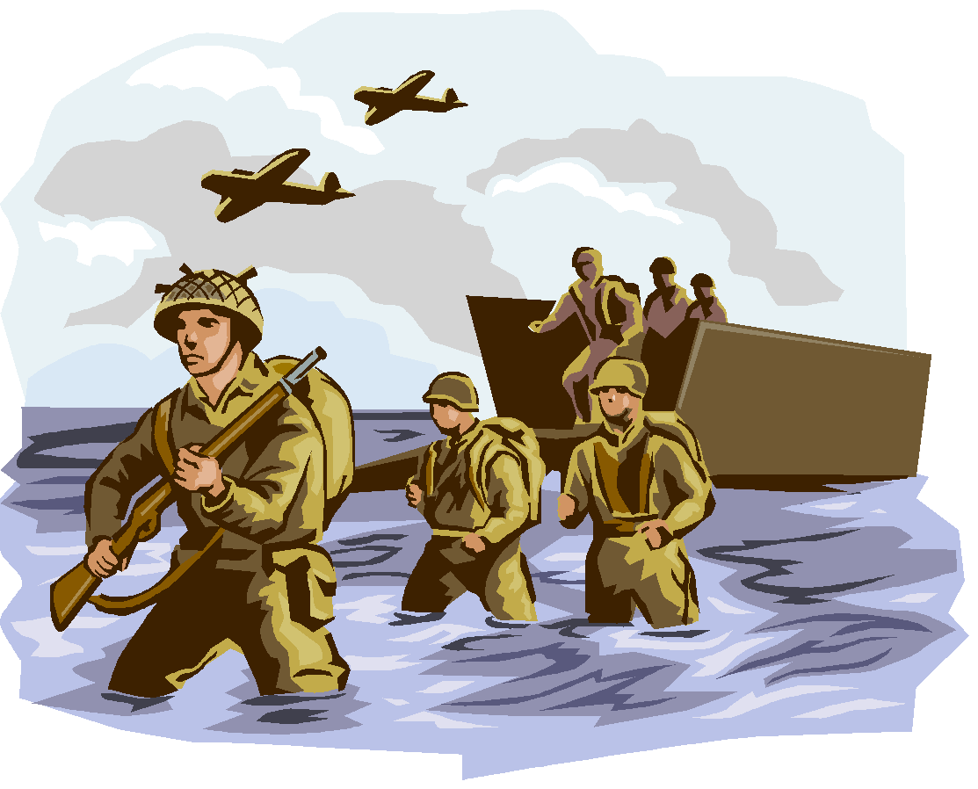
World War II (1939-1945)
10-11 War on the Western Front… Europe and Africa

Slide 3
Setting the Stage
BACKGROUND
THE FALL OF EUROPE
German tanks & armored troop carriers swept into Poland
Poland resists, but…
Polish army unprepared for such modern, mechanized warfare
Polish Calvary: men on horseback
German Calvary: tanks
Nazi attack so fast and devastating, called blitzkrieg
Lightning-fast warfare
USSR attacks Poland on other side
Nazi / Soviet Non-Aggression Pact
In just week…
Poland wiped from map altogether!!!
Divided b/w USSR & Nazi Germany
Signal of what’s to come!
April 1940- Hitler leashes blitzkrieg again
Denmark, Norway, Belgium, Luxembourg, & Netherlands all fall to Nazi’s
Nazi’s turns toward France
Italy declares war on Allies, too!
Attacks France from south
Nazi troops take Paris, and France surrenders
By July, only Britain unconquered & willing to fight
New Brit PM, Winston Churchill vows to “fight on,” and “never surrender!”
Brit RAF fought German Luftwaffe to standstill
Hitler forced to give up plans of attacking Britain across English Channel
Britain remained, but Hitler controlled rest of Europe!

Slide 4
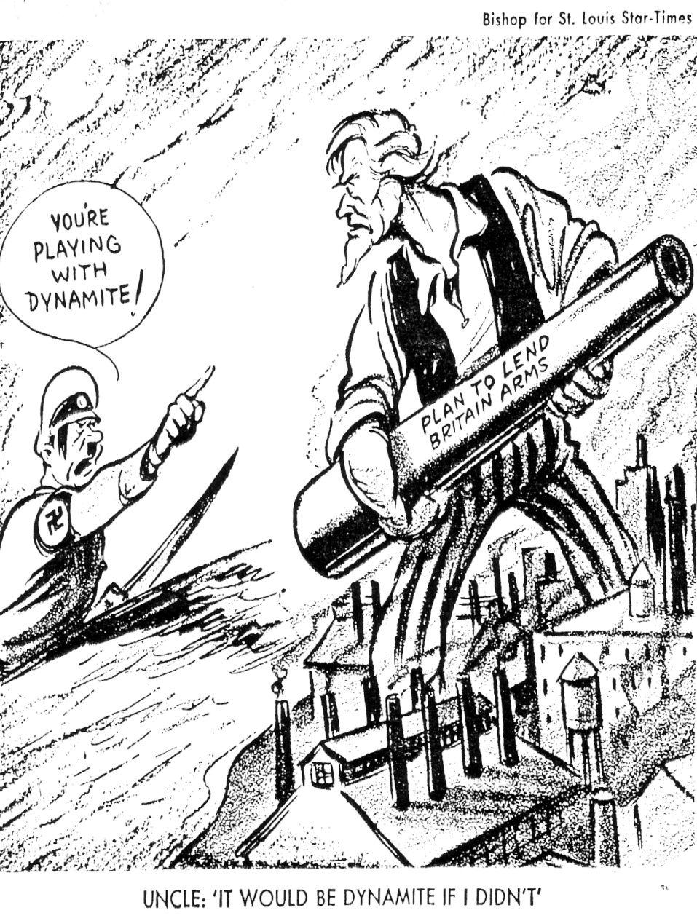
Isolationism No More
As Nazi’s roll Europe in ‘39 and ‘40
Rest of world takes sides
Isolationism strong in US, but…
FDR convinced have to help Allies
Stays course though, asks Americans to stay neutral even if can’t in heart
FDR does get Congress to tweak Neutrality Acts
Allows for sale of arms to Allies
Also pushes through the Lend-Lease Act in 1941
Said US could lend or lease raw materials, equip, soldiers, and weapons
Under LLA, US sent $50 billion worth of war goods to Allies
4) Lend Lease?

Slide 5
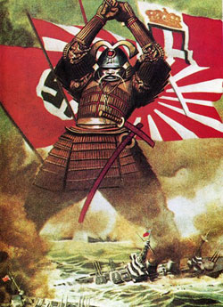
Japan Joins the Party
War starts in Europe in 1939, but…
Going on in Asia for 2 years!
1937- Japan declared all-out war on China
1940- Japan sees opportunity to expand further when France falls
Sept 1940- Japan joins Axis of Eee-vil
Immediately invade French Indochina (modern-day Vietnam)
Take it all by July 1941!!!
FDR tries to get them to stop by places embargo on Japan
Forbids any trade of US goods to Japan… including oil!
Doesn’t work…
Japan invades oil-rich Dutch East Indies
New military gov’t controlled by Gen. Hideki Tojo
Japanese strategists know only one who can stop Japan is US Navy
To guarantee success… must destroy US Pacific Fleet at Pearl Harbor in Hawaii

Slide 6
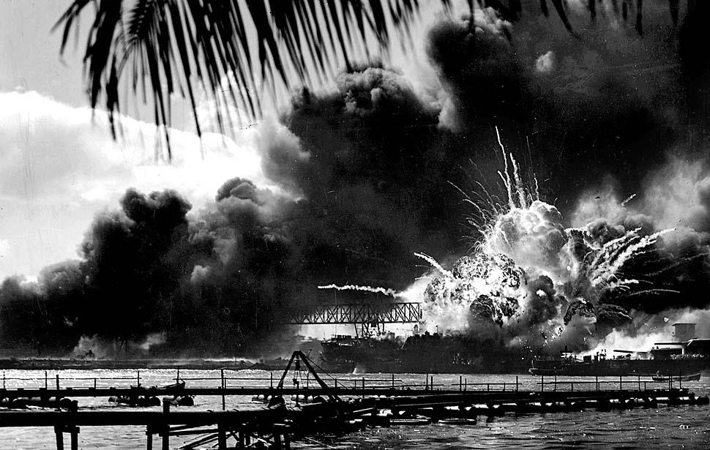
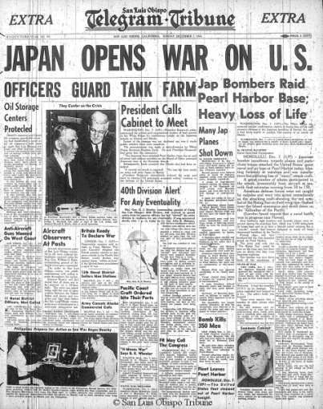
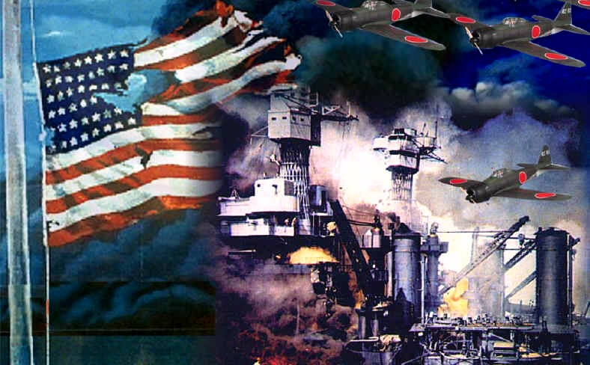
“A day which will live in infamy…”
Morning of 7 Dec 1941
Japanese “Zero’s” launch all-out attack on US Navy base at Pearl Harbor, Hawaii
Before over…
2,400 sailors die
Most planes & ships destroyed
Everything else damaged
Luckily… (conspiracy theory here)
All aircraft carriers were at sea!
FDR reports this to Congress
Calls for Congress to declare war on Japan
11 Dec 1941-
Hitler & Mussolini declare war on USA to support their ally Japan
USA finally pulled in to WW2!
US rushes to prepare for war
FDR & Churchill plan strategy
Agree to concentrate on Europe first, then take on Japan
Also agree to bring in another USSR
Notes:
Pearl Harbor Attack Scene (6:53)

Slide 7
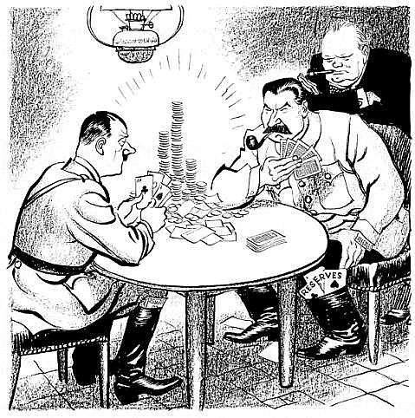
Hitler Pokes “the Bear”
When Hitler couldn’t take Britain…
22 June 1941- Turns toward USSR
Blitzkrieg very effective against Soviets
Heavy casualties
Early success
In fall rains turn ground to mud
Blitzkrieg slowed to crawl
By December, freezing Russian winter grinds Nazi’s to halt
Only 18 miles from capital, Moscow!!!
Germans split troops attacking N and S
Leningrad in north, Crimean oil fields in south
Nazi’s spend 2.5 years trying to take Leningrad
1 million+ die (mostly starvation though), but…
City never falls!
1942- Hitler turns toward Stalingrad
Ends in disaster
1943- USSR defeats Nazi’s in largest ever tank battle
Signals failure of Hitler to take USSR
Allies helped by sending supplies constantly
Wanted Hitler busy on east while they attack on the west

Slide 8
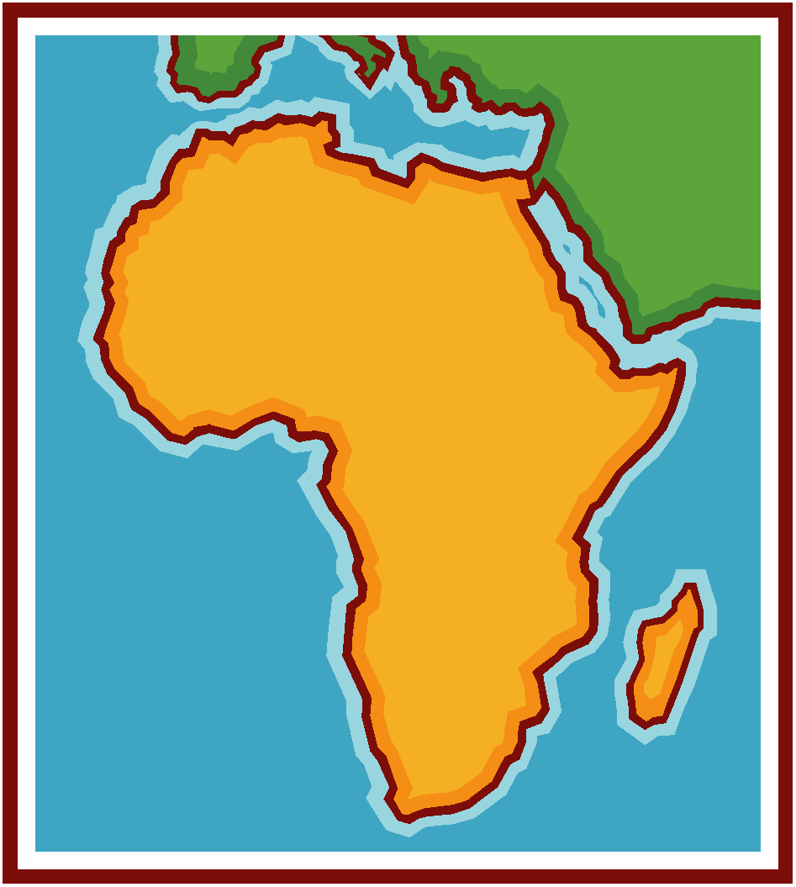
Battles in Africa & Italy
While Germans dealt w/ USSR, Britain & US turn toward North Africa!?!
Why???
Control Suez Canal
separates Europe from Asia
Jump-off point to attack Nazi-controlled Europe from south
May 1942-
Allies control N. Africa
Summer 1943-
Allies take Sicily & invade Italy
Italy soon collapses
Mussolini is arrested
Nazi’s forced to turn attention to help Italy
While Germany turns to help Italy…
Allies plan another invasion of Europe

Slide 9
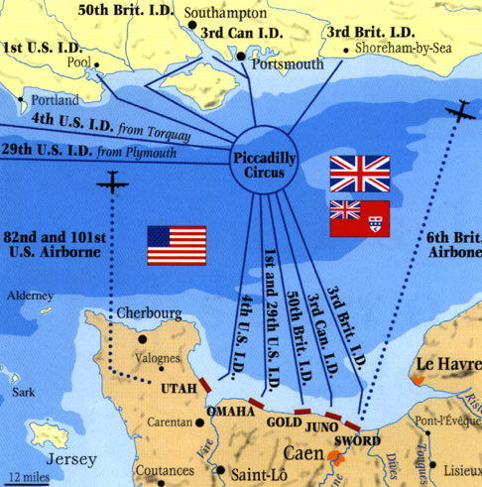
Allied Advance…
9) Describe D-Day
6 June 1944-
5,000 Allied ships
130,000 soldiers cross English Channel to coast of Normandy, France
US, British, & Canadian forces
Largest sea invasion in history!!!
Allied Gen. in Command Dwight D. Eisenhower planned it
Code-named… D-Day
Faced horrific task
10,000+ died when landed but…
By end of the day they had the beaches and could move inland
By July… 850,000 Allied troops had arrived
25 Aug 1944- Allied troops freed Paris from Nazi control
Allied forces push Nazi in from west
USSR pushing Nazi in from east
Allied troops pushing Nazi in from south through Italy
Germans make final attempt in Belgium
Battle of Bulge caught Allies by surprise, but quickly regrouped and defeated the Nazi force again
Feb 1945- Nazi’s retreating everywhere
10) Battle of the Bulge?
Notes:
Saving Private Ryan- Omaha Beach Scene (4:35)

Slide 10
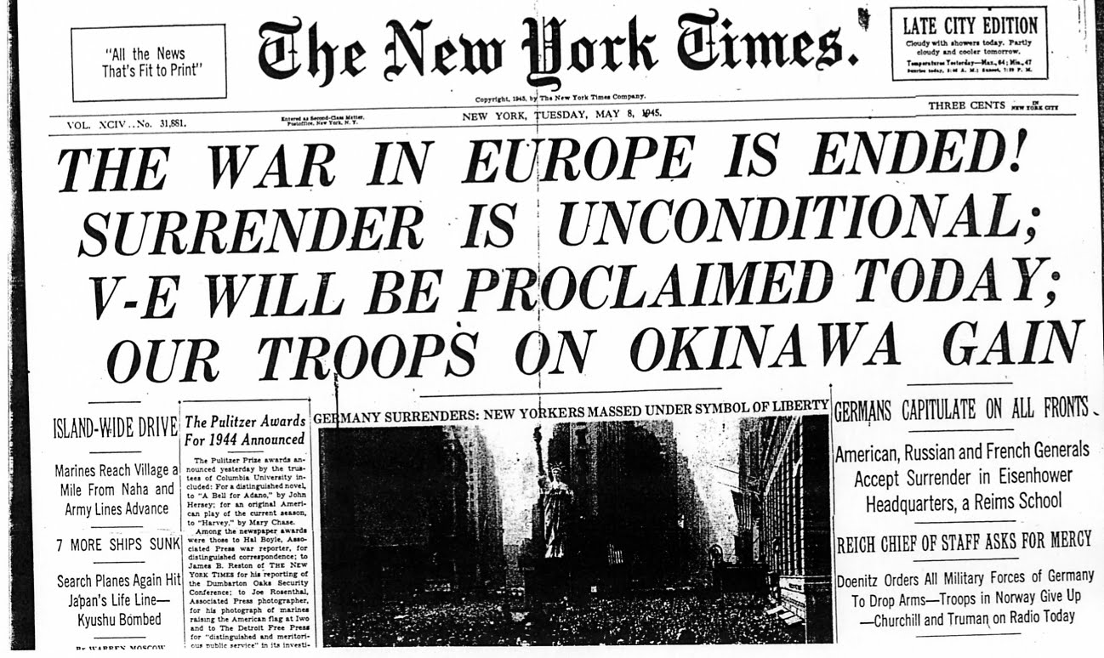
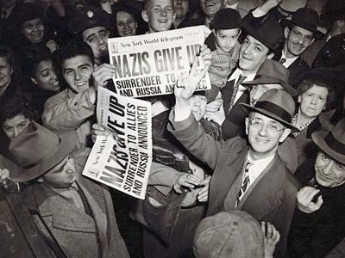
V-E Day
April 1945- FDR dies
VP Harry S. Truman takes over
Truman quickly picks up war effort
Late April- Soviets reached Berlin, the German capital
Hitler hid in under-ground bunker and…
30 April 1945- Hitler commits suicide
2 May 1945-
USSR takes Berlin
7 May 1945-
Nazi leaders sign unconditional surrender @ Eisenhower’s HQ in France
8 May 1945-
Declared V-E Day!!!
Victory in Europe Day
War in Europe finally over!!!

Slide 11
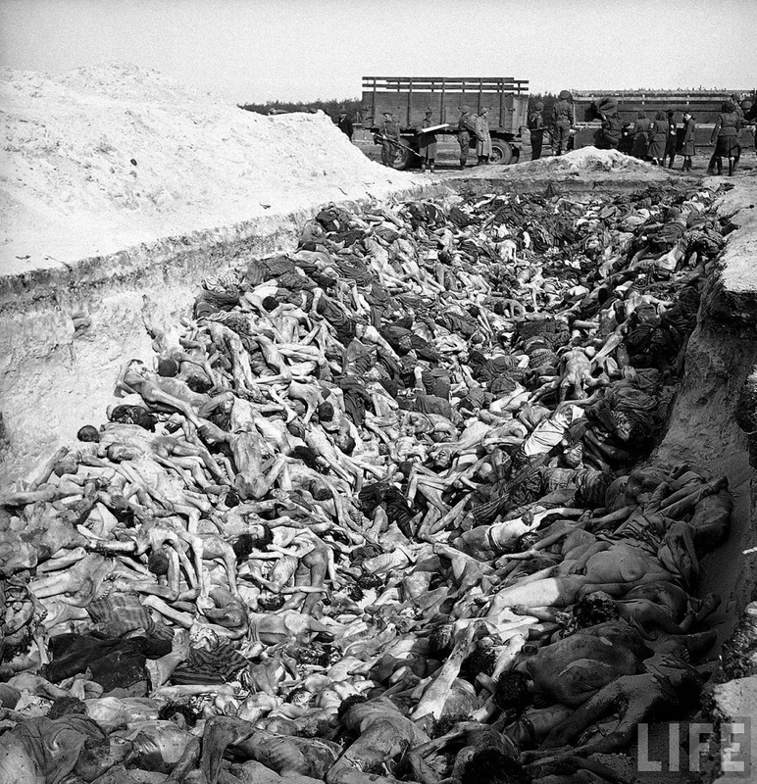
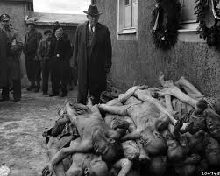
The Horrors of the Holocaust
As Allies fought toward Berlin
Horrifying discovery… Nazi Death Camps
Jews, Gypsies, & homosexuals
All gathered up from German controlled lands
Sent to these camps to be worked, beaten, starved, gassed, or burned to death
Est. 11,000,000 killed in these camps!!!
Hitler started these in 1941
Called these the “final solution of the Jewish problem”
Really called a genocide- killing off of an entire race
Hitler’s SS Officers rounded up and hunted down every Jew in Nazi Empire
Kill 100’s at a time in gas chambers, large ovens, or buried in enormous open graves
After Allies freed camps…
Put Nazi leaders on trial
Called Nuremberg Trials
Charged w/ crimes against humanity

