Slide 1
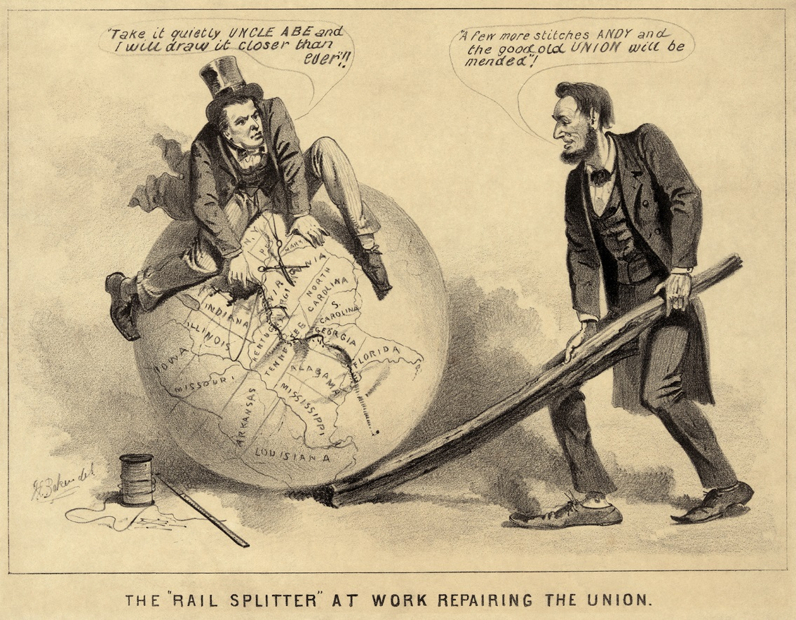
Warm Up
How did Lincoln’s death change the course of reconstruction?
1) Warm Up

Slide 2
Reconstruction & Its Aftermath
8-5 Congress Takes Charge

Slide 3
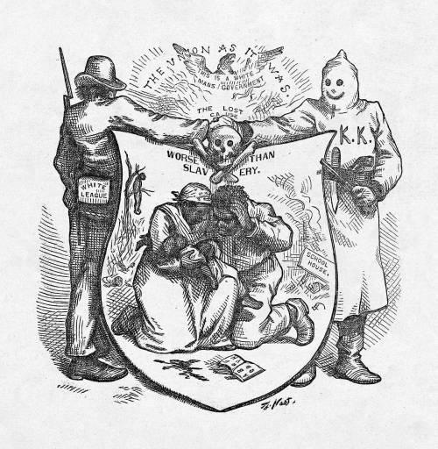
Anger Over Black Codes
2) Visual Vocab
Many Northern Congressmen upset w/ Johnson’s “Restoration”
South should be punished more
Final straw…
Southern states pass Black Codes
Laws that strictly limited freedom of former slaves
AA’s could not…
Own guns or meet after dark
Jailed w/o jobs
Only jobs allowed was farmer or servant
No voting
Many believed if laws allowed to stay… Civil War would have been all for nothing
Soldiers died in vein

Slide 4
Setting the Stage
3) Joint Committee?
Radical Republicans opposed Johnson’s plans
Wanted to protect rts. of former slaves & severely punish south
Also wanted to give freedmen the vote b/c…
Right thing to do
Probably vote republican
Moderate Republicans
Less eager to punish but…
Still not happy w/ Johnson’s plan
Both groups believed Congress should make rules for reconstruction
1865- Congress sets up Joint Committee on Reconstruction
Members of both Senate and House
Tasked to create plan to replace Johnson’s

Slide 5
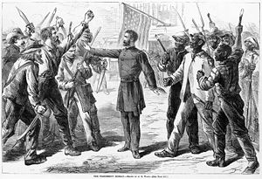
Freedmen’s Bureau Extension
4) Bill?
1st recommendation of committee was new Freedmen’s Bureau Bill
Passed in Feb. 1866
Extended life of Freedmen’s Bureau
There to continue w/ aid of former slaves as transition into citizens
Provided…
Food
Medicine
Land
Education

Slide 6
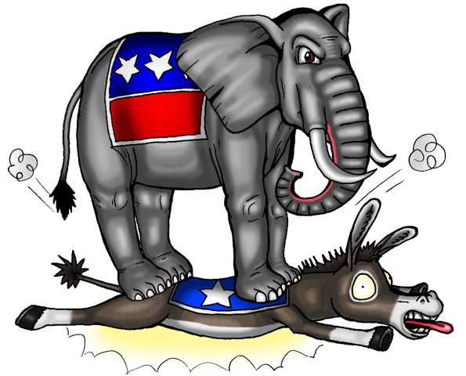
Johnson and Congress Clash
5) He did what?!?
Johnson refused to sign bill into law?!?
Why???
Bill also gave Bureau power to try cases against people interfering w/ civil rights of AA’s
Johnson believed these should be handled by states
June 1866- Congress passes 14th Amendment
Defined US citizenship to include AA’s
Johnson urges Southern states to oppose it
What!!!
Southern states weren’t yet allowed to represent in Congress yet
Johnson then declares war on Republicans in Congress
Tries to fill Congress w/ Democrats
Doesn’t work
Republicans win 2/3rds of seats in both House and Senate
6) 14th

Slide 7
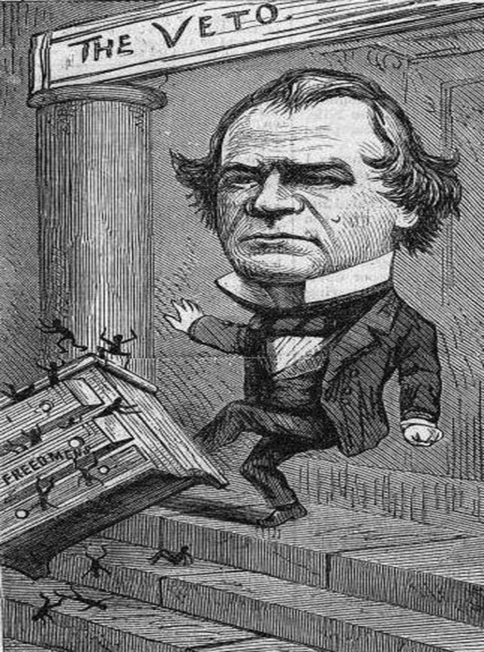
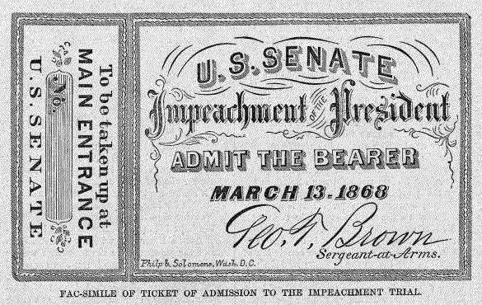
Congress in Control
7) Martial Law
With such a majority…
Republicans took control of reconstruction
2 March 1867- put south under Martial Law, or military law
Divided 10 Rebel states in 5 military districts and set in the army to take over
can’t become state again until elect new reps and write new constitutions
AA men over 21 would be allowed to vote
Former Confederate leaders & politicians could not vote or run for office
Each state would have to ratify 14th Amendment
b/c Johnson disapproved of Congress plans…
He vetoed everything, and ignored their overrides
Congress had had enough!
Feb. 1868- Congress votes to impeach , or charge Johnson w/ crimes
If found guilty, removed him from office
Vote takes place after trial and is allowed to remain as President by single vote!
8) Impeach
Notes:
America's Argumentative Adventure: The Politics of Reconstruction -- NHD Project (10:01) on ticket

Slide 8
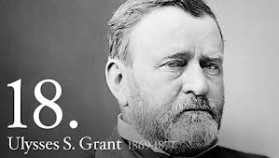
President Ulysses S. Grant
9) 15th
1868- Republicans help elect US Grant
They could work w/ him!
Southern black vote pushed him over the top
Encouraged Republicans to secure voting rts for all AA men
Feb. 1869- Congress passed the 15th Amendment
Says vote can’t be denied on “account of race, color, or former condition of servitude”
Former Confederate states had to sign it or they could not get their states back from military control
Also helped in North where freedmen where still not allowed to vote

Slide 9
Exit Ticket: Digital Activity
Discovery Education Reconstruction Reading
Open the 8-4 CCR Discovery Ed assignment on Goformative and complete the assignment using the link on the left.
*You will first need to go to MY NC ED CLOUD and login and click on Discovery Ed to get the link to open!

