Slide 1
9-2 How the West was Developed
GOLD , SILVER, & LAND attracted THOUSANDS of settlers to the west!!

Slide 2
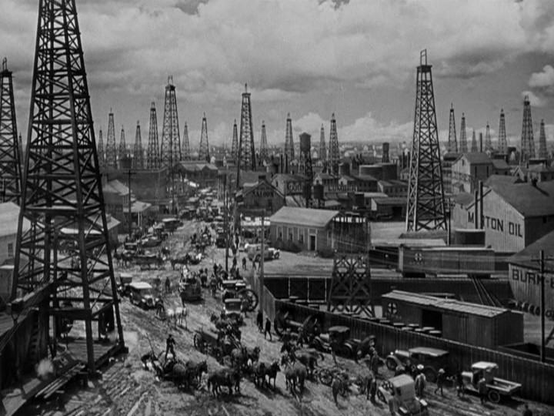
Mining
Westward why?
Gold is discovered at Pike’s Peak
1858 new gold rush this time in Colorado
Comstock Lode discovered
Discovered veins (gold and silver) in Nevada
Named after an owner of the claim
Yielded about 300 million plus in gold and silver.
Mining Companies form
Gold was found in deep veins
It took many workers and expensive machinery to extract it.

Slide 3
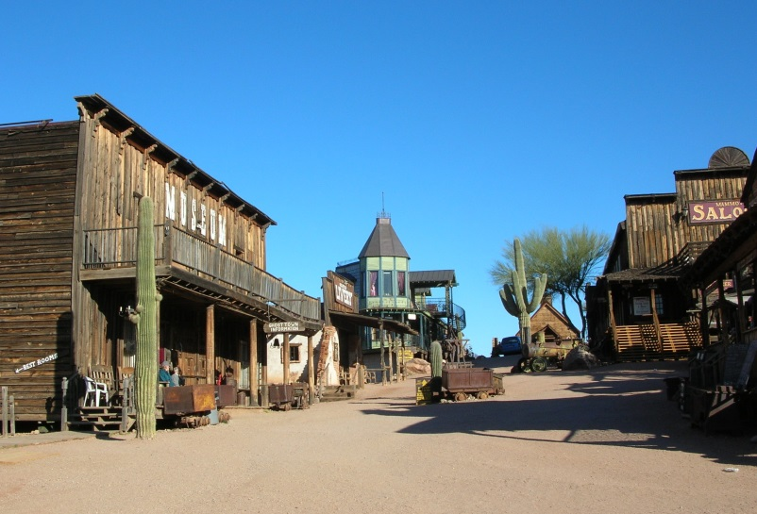
Mining
Boomtowns appear
Towns that went up almost overnight
Often wild and lawless places
Citizens formed vigilante groups to act as judge jury and executioner.
Most people carried guns
Spent money on gambling and extravagant living
These places begin to carry name the “WILD WEST”
(Examples: Dodge City, Abilene, Tombstone)
Appear almost overnight?

Slide 4
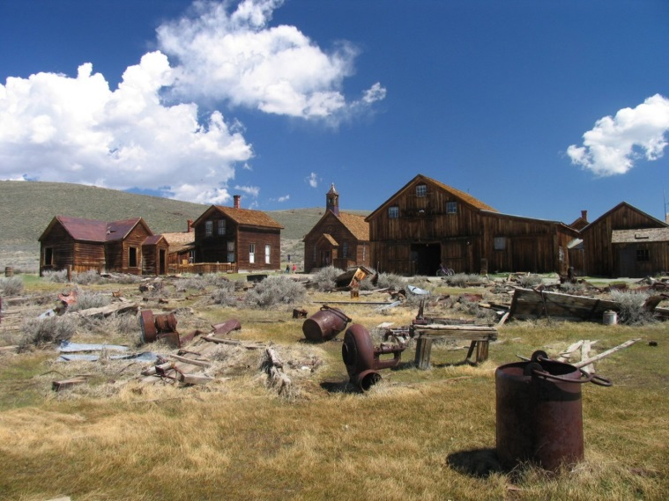
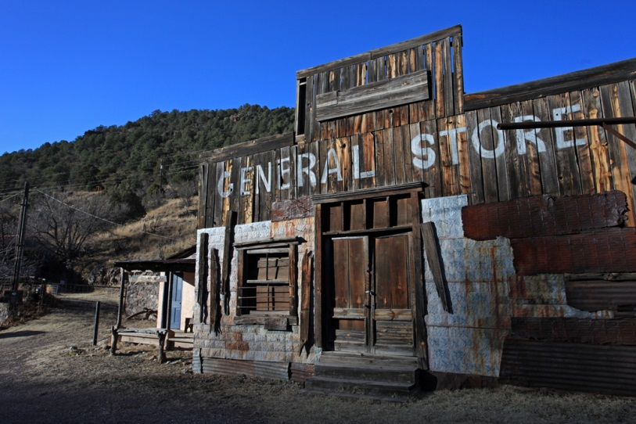
Mining
Many boomtowns turn into ghost towns
Many boomtowns become completely deserted when the local mines dry up.
After mining boom ended most people stayed in the West allowing territories to apply for statehood.
(Examples: Colorado 1876, Montana 1889, and Wyoming 1890)

Slide 5
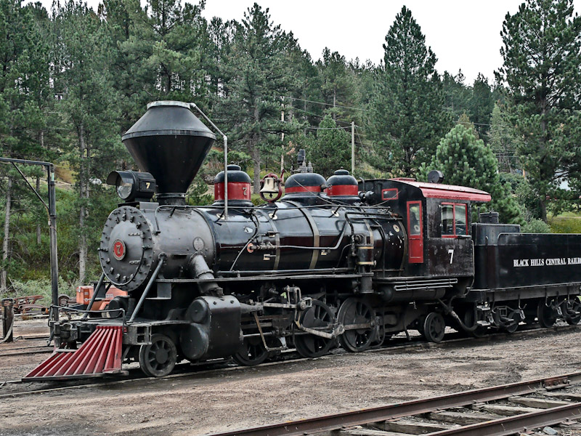
RAILROAD
Railroads expand to meet needs of Western miners
A better transportation system was needed other than wagon trains and stagecoaches
Why???
to get raw materials to the East and goods and supplies to the people in the West.
Railroads receive government grants
Argued that they should receive free land on which to lay track because railroads would benefit whole country
Received 130 million acres of land
Included a 20-80 mile wide strips of land along railway

Slide 6
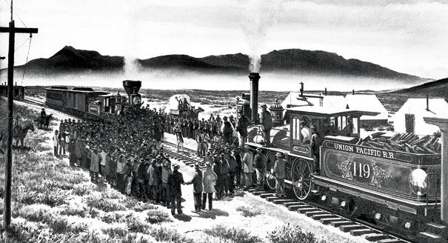
Railroad
Transcontinental railroad completed
2 companies chosen – Union Pacific and Central Pacific
Union Pacific built west
relying on Irish and AA workers
Central Pacific built east
relying on Chinese workers
Worked in nasty conditions
Met in Promontory Point, Utah on May 10, 1869

Slide 7
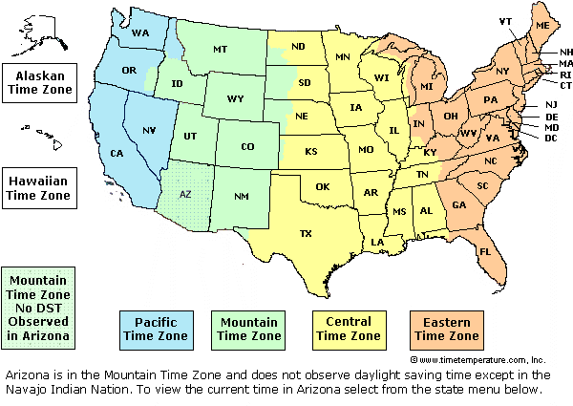
Railroad
Think about it?
Impact of Railroads
More settlers move west
Raw materials shipped east, manufactured goods shipped west
Boosted American industries (steel, coal etc.),
New towns popped up along rail lines
Because of the demand for sensible train schedules our country was split into 4 time zones in 1883
Became official in 1918.

Slide 8
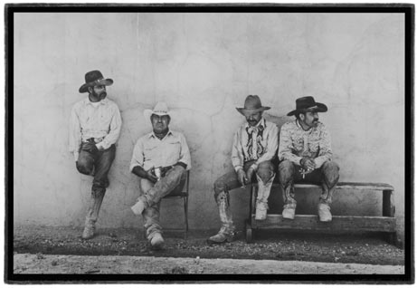
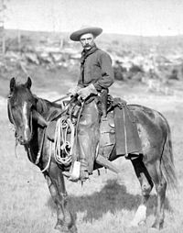
Ranchers
Spanish cowboys called vaqueros
Where most of the rancher language comes from
Where equipment was developed from
(Examples: rancho, chaps, lariats, wide brimmed hat)
Longhorns were driven to Northern rail towns to be shipped to market for their beef.
Most famous trial was the Chisholm Trail
(Texas to Kansas)

Slide 9
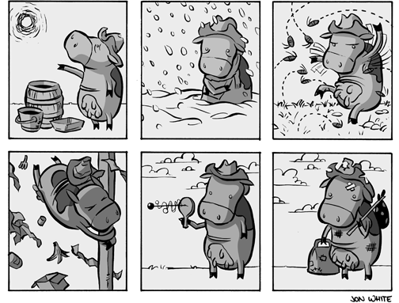
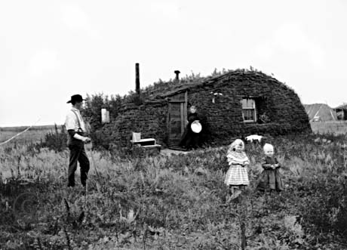
Pioneers
Define
Homestead Act increases settlement of Great Plains
Offered 160 acres of free land in 1862
Had to pay a filing fee and live on the land for five years
Encourage people to settle the Frontier
Oklahoma opened to homesteaders
Last area of the Frontier

Slide 10
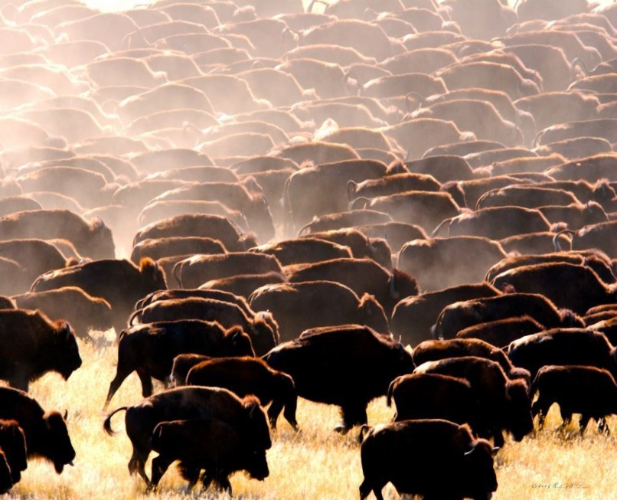
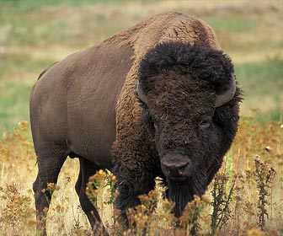
Native Americans
Used animal for food and other essentials of life
American hunters began to slaughter the buffalo so they would not;
block trains,
for sport,
or for their hides
Government encouraged this to try and force Indians to change to a farming life style

Slide 11
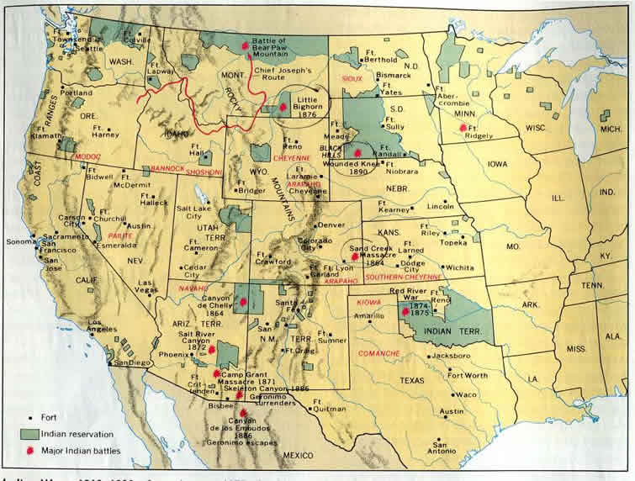
Native Americans
Government moves Native Americans to reservations
Gov. broke many promises to deliver food & supplies.
What was delivered was of inferior quality
Some NA accepted policy and relocated peacefully
Where others did not
Lead to the Indian Wars (mainly with the Cheyenne and the Sioux)
Define

Slide 12
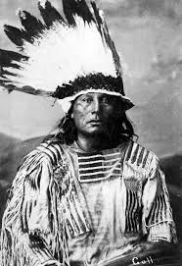
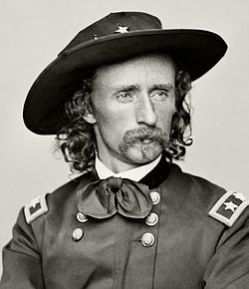
Native Americans
Native American resistance leads to war
Chief Black Kettle and the Cheyenne resisted after more than 100 men women and children were killed by US army.
General Custer killed Black Kettle and most of his followers in 1868.

Slide 13
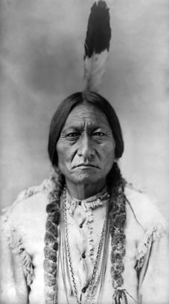
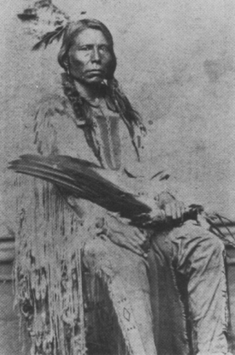
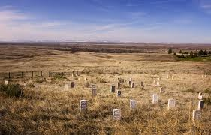
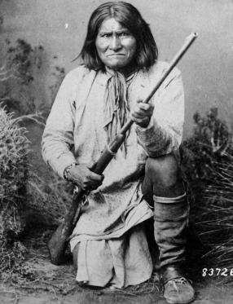
Native Americans
Little Bighorn
1000s of Sioux and Cheyenne warriors under Sitting Bull and Crazy Horse surrounded and killed General Custer and his men.
Geronimo
Apache warrior who fled to Mexico with his men after escaping the reservation
led raids on the people of Arizona.
Last Native American to formally surrender to US in 1886
What Happened

Slide 14
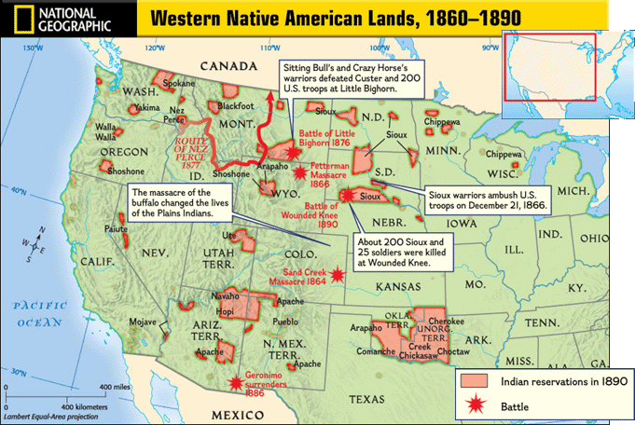
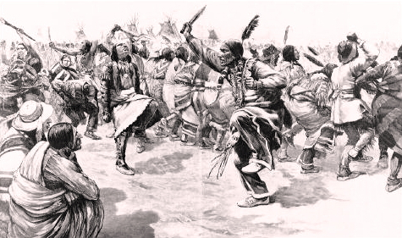
Native Americans
What Happened
Sioux prophet prophesied in 1890
That if they perform a ritual dance known as the ghost dance the Sioux would regain its former home
Believed it would reunite the living with the spirits of the dead and bring peace, prosperity, and unity to native peoples throughout the region
Believing that Sitting Bull was behind this dance the US army went to his camp to arrest him and he was killed in the scuffle
Several hundred Sioux fled in fear after Sitting Bull’s death.
They gathered at Wounded Knee Creek in South Dakota.
December 29, 1890 all the men women and children were slaughtered at Wounded Knee by the US army after a shot rang out.
Conflict with Native Americans ends with the Massacre at Wounded Knee
Importance

Slide 15
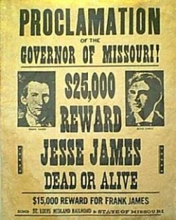
Exit Ticket
Exit Ticket
In what ways did the transcontinental railroad help boost the American Economy?
How did conflict with Native Americans and US Gov. grow and how did it come to an end?

