Slide 1
A growing nation
Visual vocabulary

Slide 2
Unit 6: visual vocabulary
Reservation
An area of public lands set aside for native Americans

Slide 3
Unit 6: visual vocabulary
Judicial Review
The right of the supreme court to determine if a law violates the US Constitution

Slide 4
Unit 6: visual vocabulary
Manifest Destiny
Idea during the 1800s that the US must expand its boundaries to the Pacific.

Slide 5
Unit 6: visual vocabulary
Annex
To add territory to one’s own territory

Slide 6
Unit 6: visual vocabulary
Embargo
An order prohibiting trade with another country

Slide 7
Unit 6: visual vocabulary
Forty-niner
People who went to California during the gold rush of 1849

Slide 8
Unit 6: visual vocabulary
War hawk
People during Madison’s presidency who pressed for war with England

Slide 9
Unit 6: visual vocabulary
BoomTown
A community experiences a sudden growth in business or population

Slide 10
Unit 6: visual vocabulary
Nationalism
Loyalty to a nation and promotion of its interests above all others

Slide 11
Unit 6: visual vocabulary
Ghost Town
Former mining towns that become deserted

Slide 12
Unit 6: visual vocabulary
Free Enterprise
The freedom of private businesses to operate competitively for profit with minimal government regulation

Slide 13
Unit 6: visual vocabulary
Spoils System
Practice of handing out government jobs to supporters, replacing government employees with the winning candidate’s supporters

Slide 14
Unit 6: visual vocabulary
Nativism
The belief that those born in a country are superior to immigrants
Nativist – a person who believes this

Slide 15
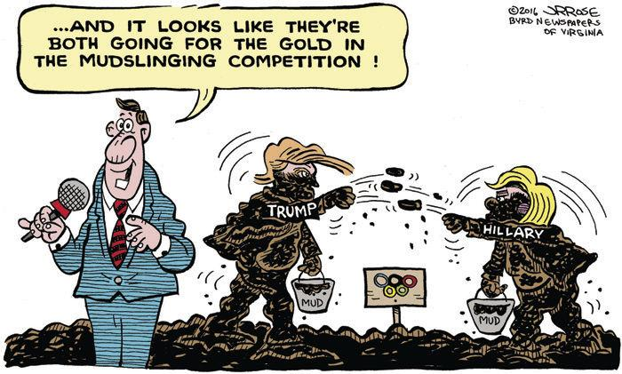
Unit 6: visual vocabulary
Mudslinging
Attempt to ruin an opponents reputation with insults

Slide 16
Unit 6: visual vocabulary
Transcontinental
Extending across a continent

Slide 17
Unit 6: visual vocabulary
Pull Factor
Something that attracts people to go and live in a particular place

Slide 18
Unit 6: visual vocabulary
Push Factor
something that makes people want to leave a place or escape from a particular situation

Slide 19
Unit 6: Visual Vocabulary
Trail of Tears
series of forced relocations of Native American peoples (specifically the Cherokee) from their ancestral homelands in the Southeastern United States, to areas to the west that had been designated as Indian Territory.

