Slide 1
A More Perfect Union
Unit 5: Visual Vocabulary

Slide 2
A More Perfect Union
Bicameral
Impressment
Federalism
Checks and Balances
Popular Sovereignty
Ratify
Amendment
Federalist
Anti-Federalist
Preamble
Judicial review
Separation of powers
Reserved Powers
Concurrent Powers
Delegated Powers
Implied Powers
Precedent
Cabinet

Slide 3
A More Perfect Union
Bicameral
Consisting of two houses especially in a legislature

Slide 4
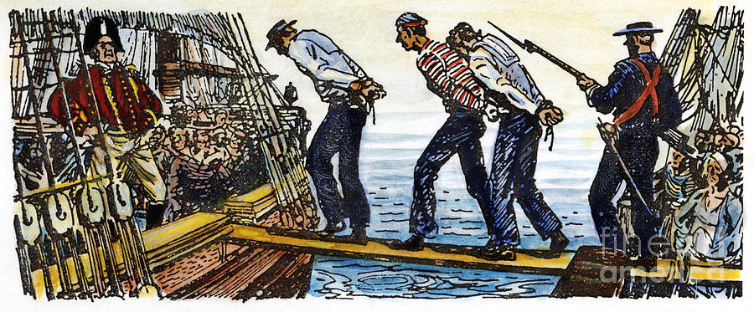
A More Perfect Union
Impressment
Forcing people into service, as in the navy

Slide 5
A More Perfect Union
Federalism
The sharing of power between federal and state government

Slide 6
A More Perfect Union
Checks and Balances
Each branch of government has a check on the other two branches so that no one branch becomes too powerful

Slide 7
A More Perfect Union
Popular Sovereignty
Theory that Government is subject to the will of the people

Slide 8
A More Perfect Union
Ratify
To give official approval to

Slide 9
A More Perfect Union
Amendment
An addition to a formal document

Slide 10
A More Perfect Union
Federalist
Supporters of the Constitution

Slide 11
A More Perfect Union
Anti-Federalist
Individuals who opposed ratification of the Constitution

Slide 12
A More Perfect Union
Preamble
Introduction to a formal document

Slide 13
A More Perfect Union
Judicial Review
The right of the Supreme court to determine if a law violates the Constitution

Slide 14
A More Perfect Union
Separation of Powers
division of the legislative,
executive,and judicial
Functions of government

Slide 15
A More Perfect Union
Concurrent Powers
Powers shared by the states and the Federal government

Slide 16
A More Perfect Union
Reserved Powers
Powers retained by the States

Slide 17
A More Perfect Union
Delegated Powers
Powers given to the Federal Government

Slide 18
A More Perfect Union
Implied Powers
Powers not specifically mentioned in the Constitution

Slide 19
A More Perfect Union
Precedent
A Tradition

Slide 20
A More Perfect Union
Cabinet
A group of advisors to the President

