Slide 1
American Revolution
The War Ends

Slide 2
Aide from the French
Washington’s plan was to attack British at Yorktown rather than New York – hoping the French would arrive
July 1780 – French Warships appear carrying +5,000 soldiers but were trapped by British
Washington waits for 2nd fleet to attack Clinton’s army
Washington knows about the fighting in the South and that Cornwallis was camped in Yorktown (changes plans)
Marches South to meet Lafayette

Slide 3
Siege of Yorktown
Patriots and French surround Cornwallis from North, South and East.
Clinton unable to help since they were expecting Washington in NYC
British supplies start running low, men are sick and Cornwallis realized he was in a hopeless situation
Forced to surrender October 19th at Yorktown
Fighting didn’t end yet, but it convinced the British that the was too costly to pursue

Slide 4
Treaty of Paris 1783
Both sides send delegates to Paris to work out a treaty.
Benjamin Franklin, John Adams, and John Jay represent US
Treaty of Paris was signed September 3, 1783
British made peace with America, France and Spain

Slide 5
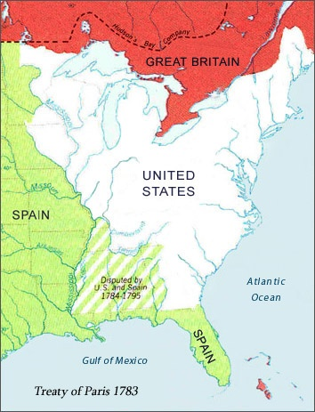
Terms of Treaty
US claimed land from Atlantic Ocean west to the Mississippi River, from Canada to Spanish Florida
GB recognized US as an independent nation
British withdraw troops from territory
Fishing rights off coast of Canada
US would allow British to collect debts from colonists
Loyalist land would be returned

Slide 6
Why Americans Won
Brave, impulsive generals
Most important…
It was the people’s cause
Had personal interest in outcome
Determination and spirit that could never be beaten
Patriots had several advantages…
Fought on own land
French and Spanish aid
Soldiers, navy, generals, $$$
Blocked Brit navy
Brits could control cities, but not countryside
Patriots knew terrain, and could hide easily

Slide 7
Lacked regular army (mostly militia)
Best Navy in the World
Experienced well trained army
No strong central government
Much larger population
No navy
Lacked experience and supplies
Wealth of world wide empire
Not everyone supported the cause

Slide 8
*Hired soldiers
(mercenaries)
Fighting on own ground
Unorthodox fighting tactics (guerrilla warfare)
Forced to fight in a far away land
Fighting for a cause, a personal stake
Did not know the terrain
George Washington (greatest advantage)
European fighting style

