Slide 1
American Revolution (April 1775- July 1776)
October 16, 2014

Slide 2
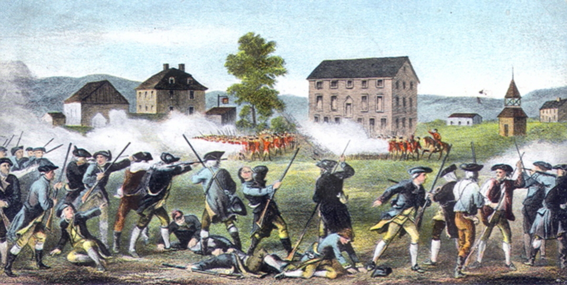
Lexington and Concord (April 19,1775)
Minutemen (colonial militia) vs. British Army
British are going to confiscate the colonists weapons in Concord
“Shot heard ‘round the world”
The American Revolution begins

Slide 3
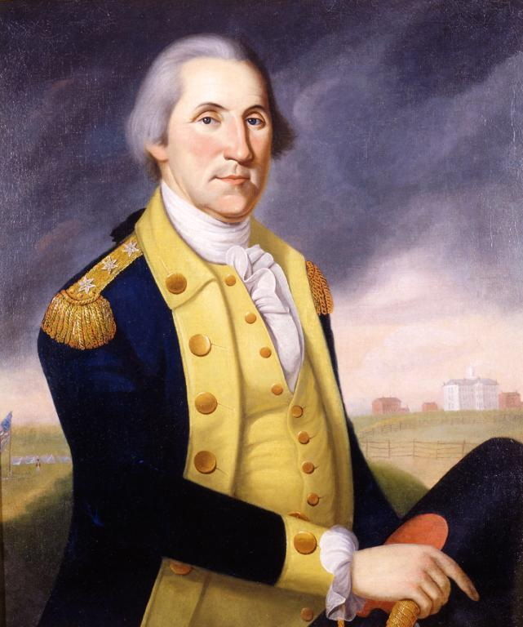
The Second Continental Congress, 1775
Accomplishments
Accomplishments
Olive Branch Petition: a letter sent to King George III wanted a happy and permanent reconciliation (King George rejected it)
Approved the Declaration of Independence
Selected George Washington as Commander of Continental Army

Slide 4
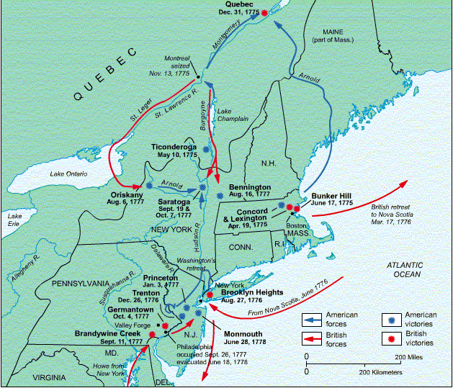
Battle of Fort Ticonderoga (May 10, 1775)
Benedict Arnold, Ethan Allen and the Green Mountain Boys captured the fort on Lake Champlain without a casualty
Captured fort for its ammunitions

Slide 5
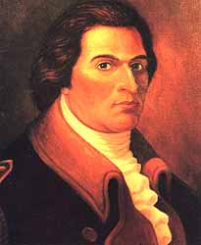
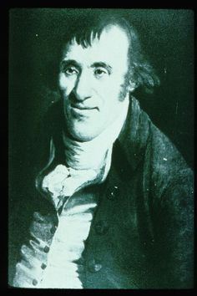
Heroes of Fort Ticonderoga
Benedict Arnold
Ethan Allen

Slide 6
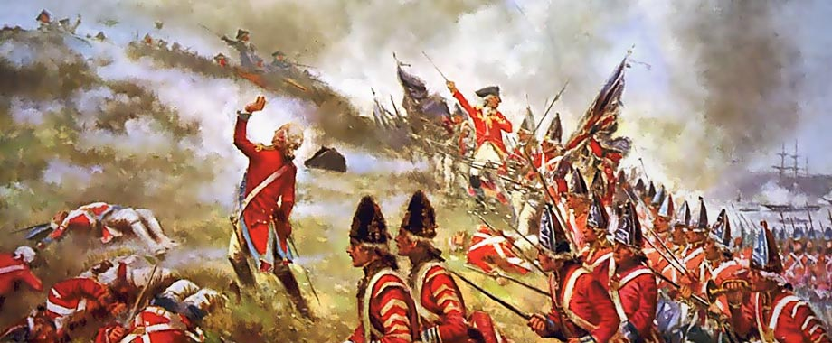
Battle of Bunker Hill (Breed’s Hill) June 16, 1775
Battle actually took place on Breed’s Hill not Bunker Hill in Boston
British marched up the hill to attack the colonist position
Famous line of American Colonel William Prescott: “Don’t shoot until you see the whites of their eyes!”

Slide 7
Bunker Hill (continued)
Fighting
Outcome
British pushed back twice.
Third time overtook the colonist position
Americans retreated only because they ran out of ammunition
Fighting lasted 3 hours
One of the deadliest battles of the American Revolution
Technically a British victory, but a moral victory for the Americans
More than 1000 British casualties
400-600 American casualties

Slide 8
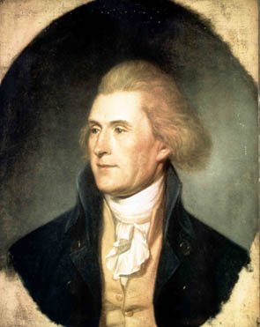
Declaration of Independence
Basic Facts:
Portrait of
Thomas Jefferson
Written by Thomas Jefferson
Approved by the Continental Congress on July 4, 1776

Slide 9
3 sections of the Declaration of Independence
The sections are:
Declaration of Rights
List of Grievances
Resolution of Independence
Go to page 186 to answer the following questions with a partner:

