Slide 1
Andrew Jackson

Slide 2
ELECTION OF 1828
JACKSON – FORMED DEMOCRATIC PARTY
JACKSONIAN DEMOCRACY – expansion of voting rights, ideas and influences in the 1820s and 1830s
JQ Adams supporters called themselves National Republicans
Jackson wins by a record number of popular votes
Spoils system – practice of giving government jobs to political backers
Martin Van Buren (Secretary of State) – one of Jackson’s strongest allies
Kitchen Cabinet – informal group of advisors of Jackson

Slide 3
STATES’ RIGHTS DEBATE
Growing conflict over tariffs, led to sectionalism – sectional differences
NULLIFICATION CRISIS – dispute led by John C. Calhoun that said states could ignore federal laws if they believed those laws violated the constitution (conflict between the supporters and opponents)
Calhoun resigns as VP, Van Buren steps into position of VP when Jackson is reelected

Slide 4
JACKSON ATTACKS THE BANKS
Opposed the Second Bank of the US (1816)
Power to act exclusively as federal government’s financial agent; federal deposits, transfers b/w states, payments/receipts
Paper currency
Belief in South – the bank only helped wealthy business people
Jackson questioned the legality of the bank
McCulloch v. Maryland –2nd Nat. bank is constitutional (ruling)
Jackson weakened Nat Bank by moving funds to state banks, helped expansion of west but led to inflation

Slide 5
INDIAN REMOVAL ACT
Nat.Am. settlements along GA – MS, but Jackson wanted to open this land to settlement for Amer. Farmers
Jackson pressures Congress to pass Indian Removal Act (1830) – removes Nat. Amer living east of Miss. River to lands west (5 tribes removed)
Indian Territory – Congress established land in US (now Oklahoma) and planned to move Nat. Amer. there.

Slide 6
CHEROKEE
Worchester v. Georgia – ruled that Cherokee nation was a distinct community which GA laws had no force, only Federal Govt had authority over Native Americans
Jackson disregards the ruling, and allows GA to move the N.Amer out anyway
Trail of Tears – Cherokee’s 800 mile forced march out of Southeast; many suffered from disease, hunger, harsh weather (1/4 Cherokee die along the way)

Slide 7
Westward expansion

Slide 8
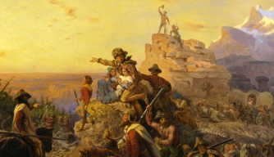
Why did people want to move west?
1. Make money
2. Land
3. Religious Freedom

Slide 9
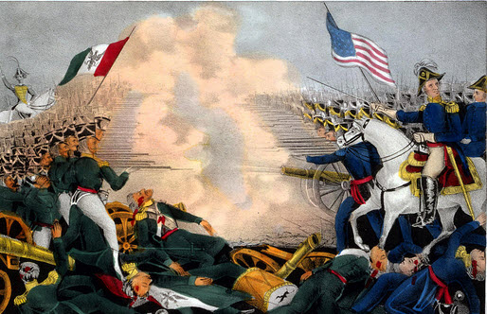
Mexican American War (1848-48)
U.S. vs. Mexico
Rio Grande River becomes the U.S. and Mexico border
California and New Mexico Territories ceded (sold) to U.S. for $15 million

Slide 10
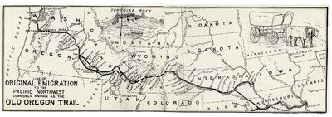
Oregon Trail
Over 2000 miles, crosses Missouri, Kansas, Nebraska, Wyoming, Idaho and Oregon
Free land and missionary work led most people here

Slide 11
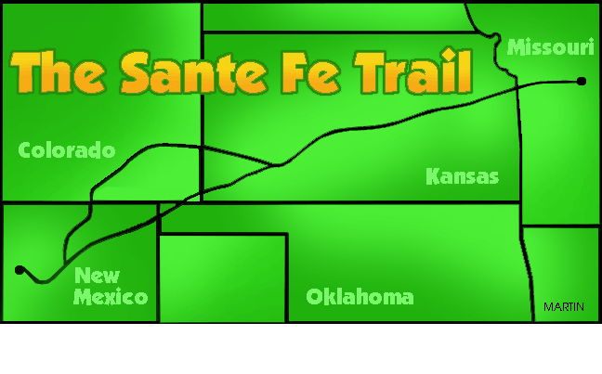
Santa fe trail (led to the Sw)
About 800 miles, crosses Missouri, Kansas, Colorado and New Mexico
Trade with Mexico led most people here

Slide 12
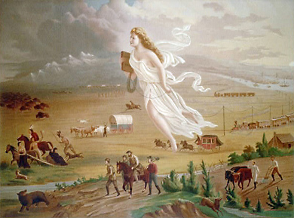
American Progress by John gast
What do you notice in the picture? Look at the background.

Slide 13
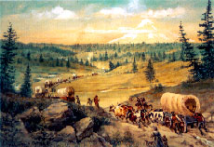
Manifest destiny
It was America’s destiny to be a nation from coast to coast.

Slide 14
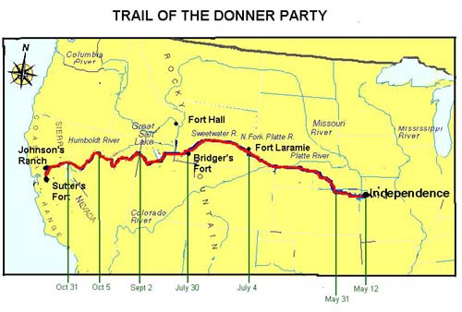
Donner Party
Left in the Spring of 1846
Led by Jacob and George Donner
Took a shortcut that actually cost them days
Decided to cross the Sierra Nevada Mountain in late October

Slide 15
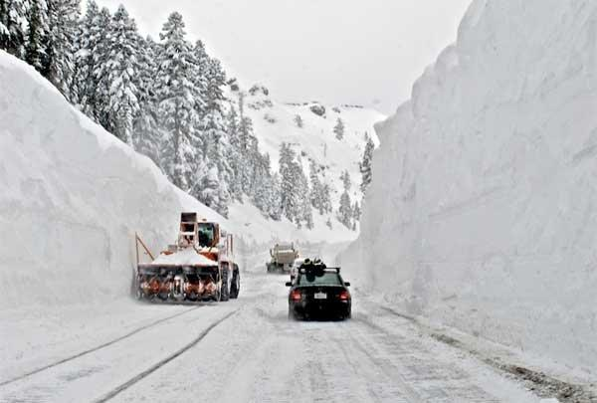
Donner party (Cont)
October 28th a heavy snowfall trapped the pioneers in the mountains
They ran out of supplies
Resorted to cannibalism to survive
Only half of the pioneers made it to California
Donner Pass during winter nowadays
Notes:
http://www.history.com/topics/donner-party

Slide 16
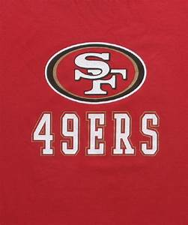
California gold rush
January 1848 gold was discovered at Sutter’s Mill in the California Sierra Nevada Mountains
Non-native population in March 1848 was around 800.
Non-native population at end of 1849 was 100.000
Around $2 billion of precious metal were extruded in the Gold Rush
Peaked in 1852
California becomes a state in 1850
Notes:
http://www.history.com/topics/gold-rush-of-1849

Slide 17
Oregon Trail (the game)
https://classicreload.com/oregon-trail.html

