Slide 1
Articles of Confederation Constitutional Convention

Slide 2
New Freedom 13 Independent State Constitutions
May 1776 – states were asked to adopt own state constitutions
Worried about too much power in single ruler – limited power of the governor
Bicameral – 2 house legislatures to divide power further
Republic – government which citizens rule through elected representatives

Slide 3
ARTICLES OF CONFEDERATION
America’s first constitution with a central government
Articles Had:
Did NOT have a way to:
Right to conduct foreign affairs
Maintain armed forces
Borrow money and issue currency
Regulate trade
Force citizens to join army
Impose taxes
Have a Chief executive
All these had to go through the individual states
Each state had 1 vote in Congress
All states had to approve the Articles and any amendments
Had limited authority

Slide 4
NORTHWEST ORDINANCE
Land policies – needed to take place because after the war, American settlers began to move west of the App Mtns; needed organization of land as states
Articles of Confederation didn’t have a provision for adding new states
Land went to central government to be divided; once reaching a certain population, could petition (apply) to Congress for statehood
Ordinance – law; for selling and surveying this western land was created and divided the territory into townships 6x6 miles (further split into 36 sections)that would be sold for cheap
Northwest Territory – single land north of the Ohio River and east of Mississippi River
Northwest Ordinance - created single NW Terr. dividing into 3-5 smaller territories, once population reached 60,000 could apply for statehood (No slavery or involuntary servitude – attempt to stop spread of slavery)

Slide 5
ECONOMIC PROBLEMS
Depreciation – value of money decreases or falls; in this case it was almost worthless
Problems with Britain – kept America out of West Indies market; J. Adams went to address problems, but Britain pointed to failure of USA honoring the Treaty of Paris; paying Loyalists for property taken.
Agreement that states would pay the Loyalists – states refused
Problems with Spain – Spain wanted to halt Americans from settling into their land west, closing the lower Mississippi River to American shipping – nothing could get to westerners
Agreement was made, but southern states blocked the agreement with Spain because it didn’t give access to the river
This showed the weakness of the Federal Government, many agreed they needed a stronger govt

Slide 6
SHAYS’S REBELLION
recession - a period when economic activity slows and unemployment increases
Farmers suffered because they couldn’t sell their goods; land was seized if didn’t pay debts and some sent to jail – resulting in protests and resentment…esp in MA
farmers wanted debt/tax relief and the govt to issue paper money
Daniel Shays (former Continental Army Capt.) led ANGRY farmers to force courts in MA to close so courts couldn’t seize farmers’ lands.
Marched toward Springfield and refused to halt at state militia’s command, resulting in 4 rebels killed
Question whether govt could control or prevent violence – would the new govt be ok?

Slide 7
CONSTITUTIONAL CONVENTION 1787
Met in Philadelphia to address the weak national government under the Articles of Confederation
James Madison and Alexander Hamilton were 2 Americans that wanted change
Originally called to discuss trade issues and address changes to the Articles of Confederation to meet the needs of the Union
Madison is known as the “Father of the Constitution” – author of basic plan of gov’t the convention adopted
Major Questions – How would members be elected to Congress? How would state representation be determined in the upper and lower houses? Were enslaved people to be counted as part of the population?

Slide 8
THE PLANS
Virginia Plan – called for a 2-house legislature;
a chief executive and a court system
# of representatives would be proportional to the population of each state – favored larger states
New Jersey Plan – called for 1 house legislature with 1 vote for each state
# of representatives should be equal – fair for smaller states (amended the Articles)

Slide 9
COMPROMISES
Should they Revise the Articles? Or write a constitution for a new national government?
Compromise – agreement between 2 or more sides in which each side gives up some of what they want
Great Compromise – Roger Sherman proposed a 2 – house legislature to incorporate both the VA plan and the NJ Plan; lower house # of seats would vary according to population (House of Rep) good for larger states; upper house (Senate) # of seats would each have 2 members, good for smaller states
Three–Fifths Compromise – dealt with counting enslaved people as population for representation of delegates. Agreed to counting enslaved for 3/5 for representation and taxation

Slide 10
BRANCHES OF GOVERNMENT
Federalism – sharing power between the federal and state governments
Articles – parts of constitution describing the responsibilities of each branch
Legislative – law making branch
Executive – headed by president to carry out nation’s laws and policies
Judicial – court system

Slide 11
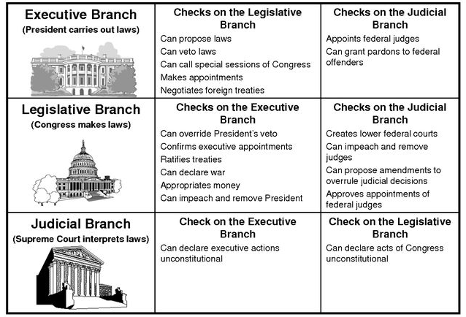
CHECKS & BALANCES
Checks and Balances - the 3 branches have roles that check or limit the others so that no single branch can dominate the government

