Slide 1
Causes of the American Revolution

Slide 2
Salutary Neglect
Navigation Acts
Responses:
Colonies could only trade with England
British:
Salutary Neglect: don’t enforce laws on the colonies
Colonies:
Smuggled goods into the colonies.
governed themselves.

Slide 3
Cause #1 French and Indian War
England went indebt fighting the French and Indian War
English debt doubled from 70,000,000 pounds to 140,000,000 pound
Wanted colonists to pay for the war (impose taxes on them)

Slide 4
Cause #2 The Sugar Act
British action:
Colonies response:
Raised taxes on-
Sugar
Textiles
Indigo
Wine
Coffee
Protested the tax

Slide 5
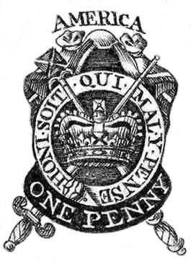
Cause #3 Stamp Act
British action:
Colonists response:
Taxed all paper goods
Newspapers
Playing cards
Calendars
Documents
Marriage
Wills
Diplomas
Direct Tax
No Taxation Without Representation
Boycott British goods
Formed the Sons of Liberty

Slide 6
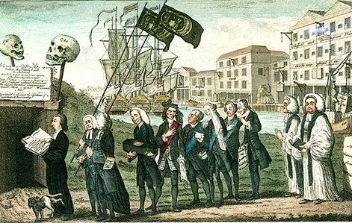
Stamp Act Repealed
The boycott worked.
This political cartoon is titled The Funeral of Miss Americ-stamp.
What symbolism do you notice in the cartoon?

Slide 7
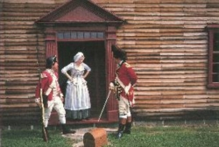
Cause #4 Quartering Act
British action:
Colonies response:
Forced colonists to keep British troops in their homes
Purpose to keep more troops in American colonies and reduce the cost
Began to despise the British “occupation” and the British soldiers.

Slide 8
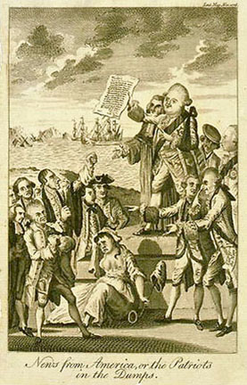
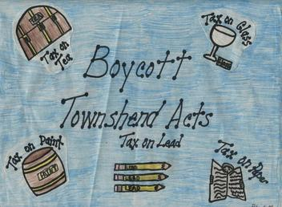
Cause #5 Townshend Acts
British action:
Colonists response:
Tax on the following products in the colonies
Glass
Lead
Papers
Paint
Tea
Boycott British goods
Boycott worked; all taxes repealed except for tea tax

Slide 9
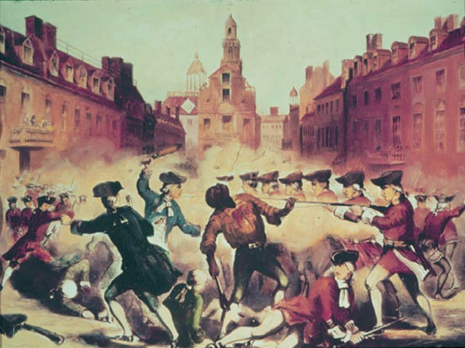
Cause #6 Boston Massacre
March 5, 1770
Started with an argument between a British private and a few colonists.
Soon a mob is yelling at the British and throwing snowballs
British fire into the crowd
5 colonists killed
Crispus Attucks 1st man killed
England sends 4,000 troops to Boston

Slide 10
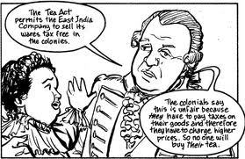
Cause #7 Tea Act
British action:
Colonists response:
Only tax from the Townshend Act not repealed
Tea Act was kept in order to maintain Parliament’s right to tax the colonies
Gave the British East India Company a monopoly on tea
Catalyst for the Boston Tea Party

Slide 11
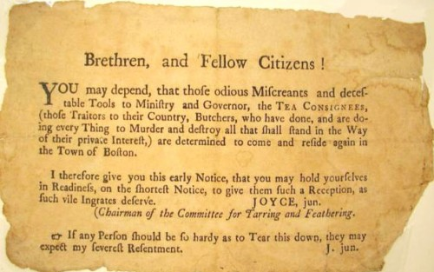
Cause #8 Boston Tea Party
An original handbill handed out for the Boston Tea Party

Slide 12
Here is what the note said:
Brethren, and Fellow Citizens!
You may depend, that those odious Miscreants and detestable Tools to Ministry and Governor, the TEA CONSIGNEES, (those traitors to their Country, Butchers, who have done, and are doing every Thing to Murder and destroy all that shall stand in the Way of their private Interest,) are determined to come and reside again in the Town of Boston.
I therefore give you this early notice, that you may hold yourselves in readiness, on the shortest notice, to give them such a reception, as such vile ingrates deserve.
JOYCE, jun.
(Chairman of the Committee for Tarring and Feathering).
If any Person should be so hardy as to Tear this down, they may expect my severest Resentment.
J. jun.

Slide 13
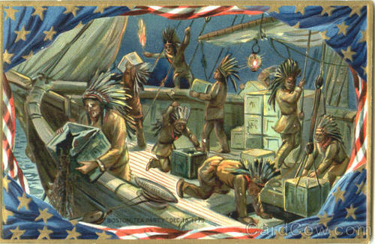
Cause #8 Boston Tea Party
Colonists action
British response:
Sons of Liberty dressed up as Mohawk Indians and dumped 92,000 pounds of tea in Boston Harbor
Value of tea was over $1 million dollars in modern-day value
The Intolerable Acts
Also known as the Coercive Acts

Slide 14
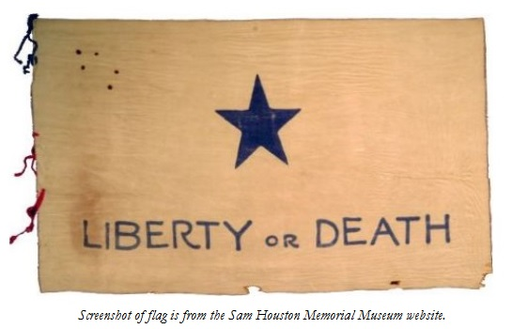
Cause #9 Intolerable Acts
British action:
Colonists response:
Designed to punish Massachusetts for the Boston Tea Party
Closed Boston Harbor
Search without warrants
Restricted trial by jury
No town meeting
Tried to isolate Massachusetts but it actually united the colonies
1st Continental Congress
12 of the 13 colonies meet
GA didn’t show up
Sent a letter “Declaration of Rights and Grievances” to King George III
Supported the “Suffolk Resolves”
Which said that the Intolerable Acts were void and Massachusetts should form its own government

