Slide 1
Civil Rights Era
Unit 11: Turning Points

Slide 2
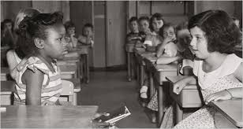
Civil Rights Era
Brown v. Board of Education
Landmark Supreme Court case that overturned Plessy v. Ferguson and said segregated schools were unconstitutional.

Slide 3
Civil Rights Era
Integration
The bringing of races together in public schools and later all public places.

Slide 4
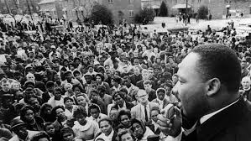
Civil Rights Era
Civil Disobedience
Refusal to obey unjust laws by protesting through non-violent methods to draw attention to your cause and make the opposition look like the enemy.

Slide 5
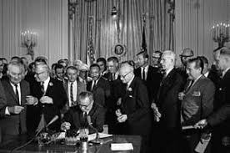
Civil Rights Era
Civil Rights Act
Legislation passed in 1964 that banned segregation in public spaces in the US.

Slide 6
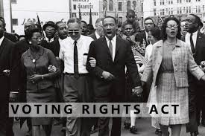
Civil Rights Era
Voting Rights Act
1965 legislation that banned methods used in the South to prevent African Americans from voting (literacy tests, etc)

Slide 7
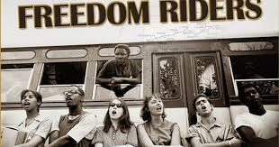
Civil Rights Era
Freedom Riders
Group in 1961 who took buses South to bring attention to segregation and voting repression.

Slide 8
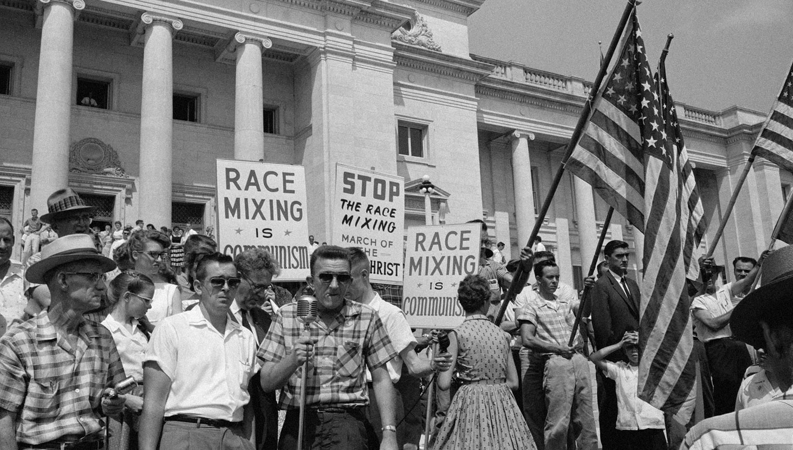
Civil Rights Era
Massive Resistance
Term used by some Southern states to oppose the Brown v. Board case through all means possible.

Slide 9
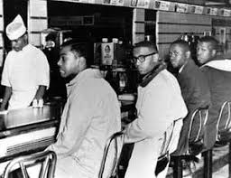
Civil Rights Era
Sit ins
The act of peaceful protesting by siting down.

Slide 10
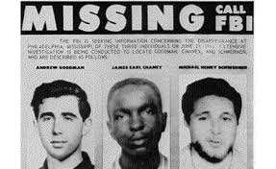
Civil Rights Era
Freedom Summer
Summer of 1964 where thousands of civil rights workers spread throughout the South to help register African Americans to vote.

Slide 11
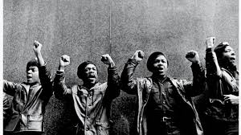
Civil Rights Era
Black Panther Party
Young radical African Americans who were frustrated with urban poverty and unemployment and led armed clashes with urban police

Slide 12
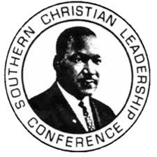
Civil Rights Era
Southern Christian Leadership Conference (SCLC)
A Civil Rights organization created in 1957 by Dr. King and 60 other ministers emphasizing nonviolent protest..

Slide 13
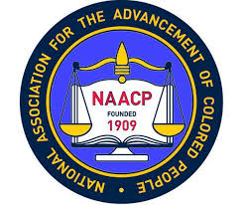
Civil Rights Era
National Association for the Advancement of Colored People (NAACP)
Civil rights organization in the United States, formed in 1909 by W.E.B Du Bois as an endeavor to advance justice and Civil Rights for African Americans.

Slide 14
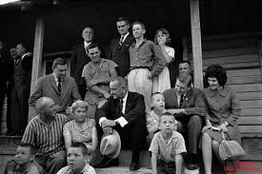
Civil Rights Era
North Carolina Fund
A statewide antipoverty program for rural and urban committees, from 1963-1968 to find new ways to enable the poor to become productive citizens and encourage self-reliance.

Slide 15
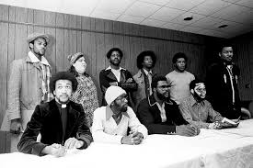
Civil Rights Era
Wilmington 10
9 men and 1 women who were wrongfully convicted in 1971 of arson and shooting at fire and police. Most were sentenced to 29 years in prison and served 10 years before an appeal won their release.

Slide 16
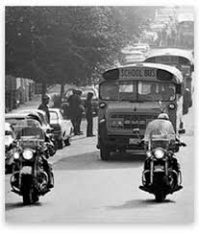
Civil Rights Era
CMS versus Swann
April 20, 1971 the US Supreme Court upheld busing programs that aimed to speed up the integration of public schools in Charlotte. Busing was soon adopted to achieve racial balance and soon adopted in many areas of the country. Charlotte became a model for “racial cooperation.”

