Slide 1
Unit 3: Colonial Settlement
Visual Vocabulary

Slide 2
Colonial Settlement
Joint-Stock Company
Investors buy stock in the company in return for a share of its future profits

Slide 3
Colonial Settlement
Charter
Document that gives the owner the right to organize settlements in an area.

Slide 4
Colonial Settlement
Colony
A group of people who leave their country to form a new settlement controlled by the parent country

Slide 5
Colonial Settlement
Indentured Servant
Laborer who agreed to work without pay for a certain period of time in return for passage to America.

Slide 6
Colonial Settlement
Militia
A group of civilians trained to fight in emergencies.

Slide 7
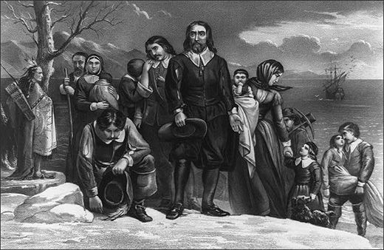
Colonial Settlement
Separatists
Protestants who wanted to leave the Anglican Church in order to found their own churches.

Slide 8
Colonial Settlement
Puritans
Protestants who wanted to reform the Anglican Church.

Slide 9
Colonial Settlement
Mayflower Compact
This was the first governing document of the Plymouth Colony and was one of the first forms of self-government in the New World.

Slide 10
Colonial Settlement
Great Migration (Puritan)
In the 1630’s an estimated 20,000 English Puritans headed for Massachusetts to escape economic hard times and religious persecution.

Slide 11
Colonial Settlement
Burgesses
Elected representatives to an assembly.

Slide 12
Colonial Settlement
Salutary Neglect
The relaxed enforcement of strict British trade laws imposed on the colonies.

Slide 13
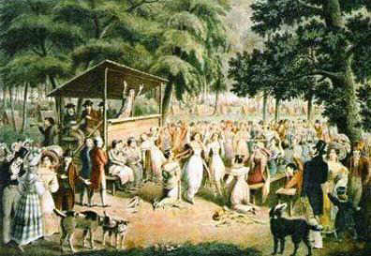
Colonial Settlement
Great Awakening
Christian revival in the 13 Colonies that renewed religious devotion

Slide 14
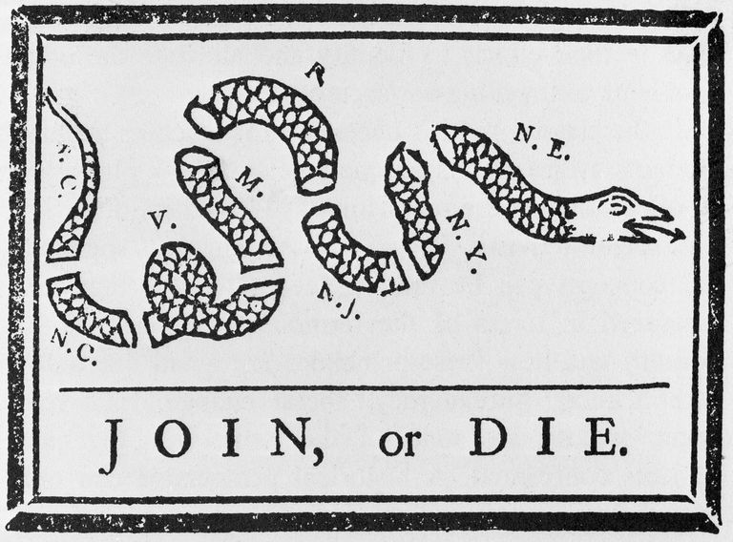
Colonial Settlement
Albany Plan of Union
Ben Franklin’s plan to unite the colonies under one general elected government with the power to tax, raise troops, and regulate trade.

Slide 15
Colonial Settlement
Pontiac’s Rebellion
1763 conflict in the Great Lakes region over post French and Indian War British policies.

Slide 16
Colonial Settlement
Proclamation of 1763
English law that forbid settlement west of the Appalachian Mountains.

Slide 17
Colonial Settlement
On the right hand side of the page;
Create a visual for each of the mentioned vocabulary
Make sure there is color and your picture pops!
Do not crowd the pictures and definitions.

