Slide 1
Early English Settlements in North America

Slide 2
Impact of Columbus
Changed the way Europeans thought of the world and their place in it.
Began a new era of interaction between Europe and the Americas.
Created conflict as countries competed to add lands to their empires.
In 1493 Pope Alexander VI, from Spain, decreed the Line of Demarcation through the Atlantic Ocean that allowed Spain to claim all lands west of the line.
Portugal and Spain then signed an agreement, the Treaty of Tordesillas, which moved the Line of Demarcation 800 miles further west.

Slide 3
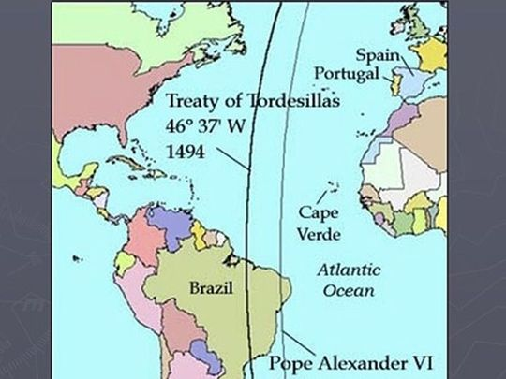

Slide 4
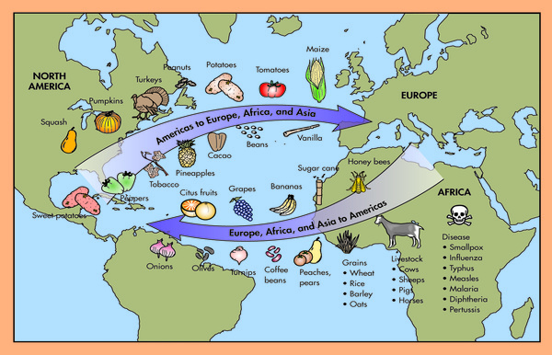
The Columbian Exchange
Explorers brought plants, animals, and diseases to the “New World” of the Americas and brought back plants and animals to the “Old World”—Europe, Asia, and Africa.
The Columbian Exchange is the name given to this transfer of plants, animals, and diseases between Europe and the Americas.

Slide 5
Spain builds an empire in the Americas
Spanish settlers treated Native Americans harshly, forcing them to work on plantations and in mines.
The encomienda system gave settlers the right to tax local Native Americans or make them work.

Slide 6
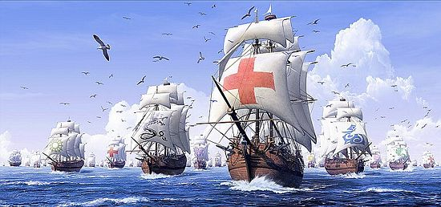
England vs. Spain
England and Spain fought for dominance as the world power.
England had been raiding Spanish ships full of gold and silver (Sir Francis Drake)
1588 Spanish Armada
Spain sent 130 ships to attack England
England defeated the Spanish fleet
Half of the ships were lost
Over 15,000 Spanish killed

Slide 7
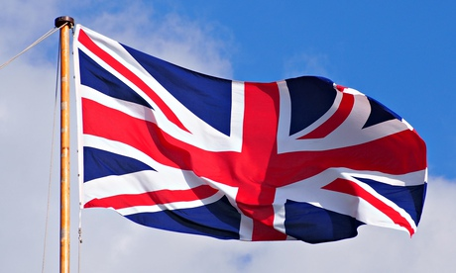
England becomes the World Power
England becomes the World Power
Wanted to cash in on gold and silver from the New World
Wanted to establish colonies in North America

Slide 8
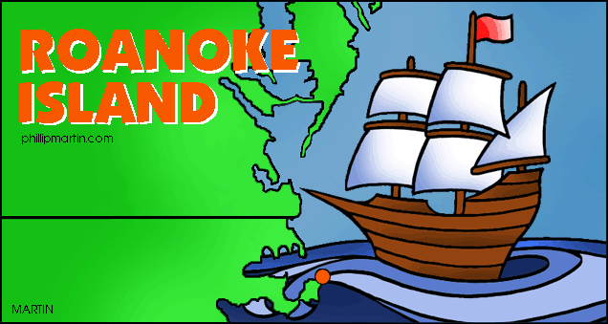
Roanoke
1st attempt at colonizing failed (1585)
2nd attempt at colonizing (1587)
Croatoan people were the American Indians in the area
Gov. John White left for supplies in August 1587
He returned August 1590
“Lost Colony”
When White returned settlement was deserted
CRO and CROATOAN were carved on a post

Slide 9
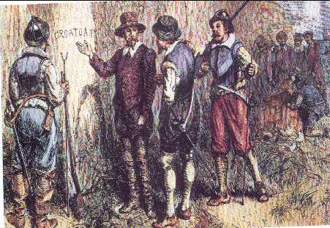
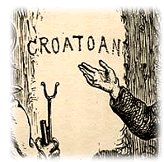
Theories about Lost Colony
Spanish came north and destroyed colony
Native Americans killed the settlers
Colonists traveled inland to friendly American Indians*
They tried to sail back to England but failed

Slide 10
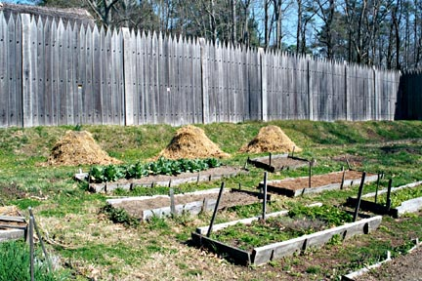
Jamestown
1606 Virginia Company of London is to establish a colony in New World
Joint stock company; investors fund the expedition in hope of making profits from the colony
1607 arrive at Chesapeake Bay, Virginia
Established a settlement on swampy land
Named Jamestown after King James I
Colonists not use to hard labor
Looked for gold and silver instead of planting crops

Slide 11
Question:
With a person next to you explain your answer to
Why would the colonists primarily looking for gold and silver be a problem?

Slide 12
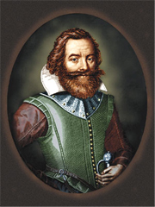
Jamestown (continued)
Captain John Smith
Experienced soldier became the leader
He saved the colony from failure
Forced colonists to work
Made peace with Powhatan Indians
Sent home because colonists
hated him. Wanted to kill him.

Slide 13
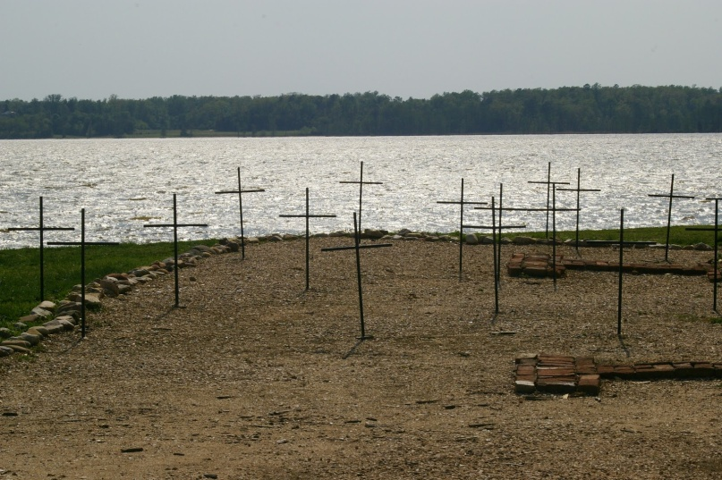
Jamestown (continued)
The Starving Time (1609-1610)
Food in extreme short supply
Powhatan used famine as a weapon; would kill colonists if they left their settlement
Colonists ate the following to survive:
Horses
Cats and dogs
Rats
Dead human bodies

Slide 14
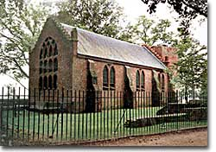
Jamestown (continued)
1st Cash Crop
John Rolfe plants tobacco
Tobacco makes a lot of money for the colonists
1st Slaves
20 slaves brought in 1619
1st Representative government
Created a legislative body in 1619 (House of Burgesses)
22 burgesses represented 11 plantations
Only white men owning property were eligible to vote

Slide 15
Departure of the Mayflower
The Mayflower brought European settlers, largely English Separatists (Pilgrims), to North America in 1620.
The ship set sail from Plymouth, England, in early September, and arrived at Cape Cod, Massachusetts, in late November.
In order to end arguments, the Pilgrims signed the Mayflower Compact in what is now Provincetown Harbor.
Although originally destined for the Colony of Virginia, the Pilgrims were let ashore at what is now Plymouth, Massachusetts.
According to tradition, they first set foot there on Plymouth Rock.

Slide 16
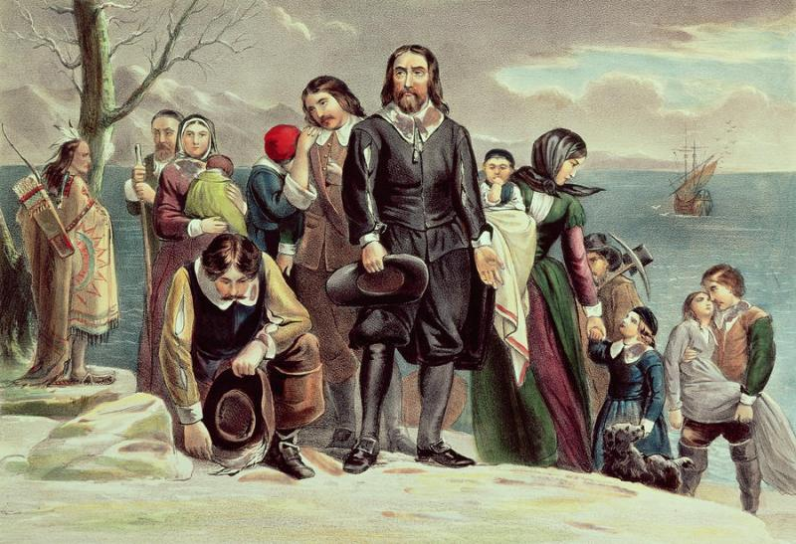
Plymouth
Pilgrims were being persecuted for religious beliefs.
Fled to Holland; still persecuted
Landed in Plymouth December 18, 1620
Half died that first winter
Squanto helped the Pilgrims
American Indian
Learned to speak English when taken to Europe (kidnapped)

Slide 17
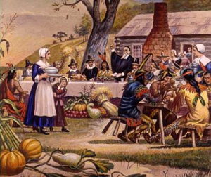
Plymouth (continued)
First Thanksgiving (Fall 1621)
Feast shared by Pilgrims and Wampanoag Tribe
Chief Massasoit (leader of Wampanoags)
William Bradford (leader of Pilgrims)
Mayflower Compact
Foundation for Plymouth government
Every adult male had to sign before coming ashore

