Slide 1
Establishing the Constitution

Slide 2
Federalists v. Antifederalists
Federalists
Antifederalists
Federalists – supporters of the Constitution
James Madison, George Washington, Benjamin Franklin, Alexander Hamilton
Many Fed’s were wealthy planters
Linked themselves to idea of Federalism – sharing the power between central and states
Promoted their views through series of essays known as Federalist Papers – which appealed to both reason and emotion
Antifederalists – people who opposed the Constitution
Thought it would weaken states rights and give central government too much power
Feared a strong President and a Senate that may become too powerful
Main problem is that Constitution did not have a section to guarantee individual rights
Many Antifed’s were small farmers, some were Patriots too
Samuel Adams, Patrick Henry, George Mason

Slide 3
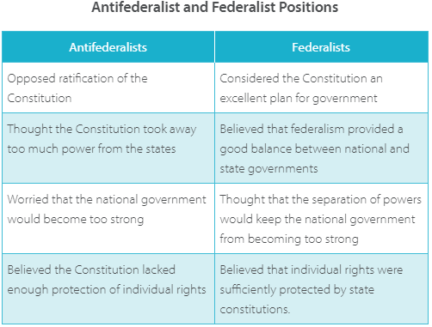

Slide 4
Ratifying the Constitution
The proposed Constitution had no guarantee that the govt would protect the rights of the people.
Thomas Jefferson wanted to add a bill of rights – a formal summary of citizens’ rights and freedoms
Federalists decide that these demands were acceptable, create bill of rights
In 1787 only 3 states ratified Constitution, by 1788 only 9 states had ratified, Virginia ratifies by end of June.

Slide 5
BILL OF RIGHTS
Madison took office in the first Congress in the Winter of 1789, took the job of writing the bill of rights.
Congress proposed 12 amendments and sent them to the states for ratification.
10 of the proposed amendments were ratified by the states and became the Bill of Rights
2/3 of each house of Congress or 2/3 of the state legislature can propose an amendment. To become a law, and amendment needs approval by ¾ of the state

Slide 6
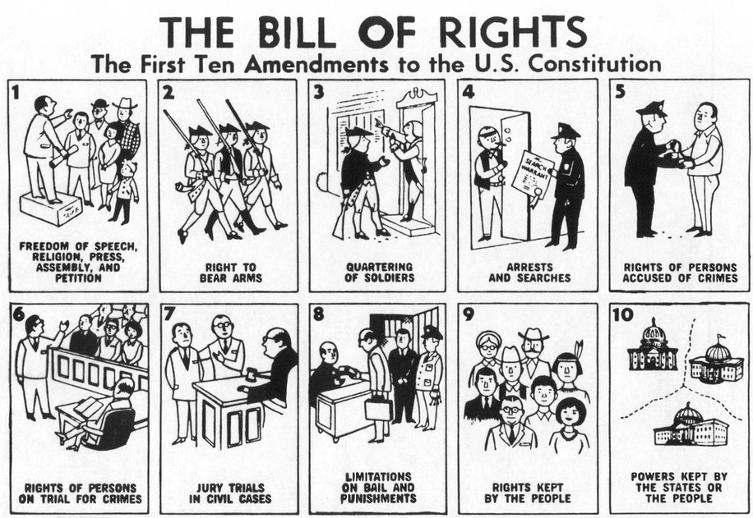

Slide 7
Separation of Powers
Federal System – divides powers between the states and the federal government
Congress (435) – Legislative Branch – every 10 years Census determines how many members represent each state
HOR- serve 2 year terms
Sen – serve 6 year terms
Vice President serves as president of the Senate
Executive – President – native born US citizen, at least 35, US resident for 14 yrs
Elected every 4 years (22nd amendment limits to 2 terms),
If President dies, resigns, or is removed the VP becomes the pres for rest of term
Judicial Branch – federal courts, headed by US Supreme Court
Judiciary Act of 1789 – legislation passed creating a federal court system

Slide 8
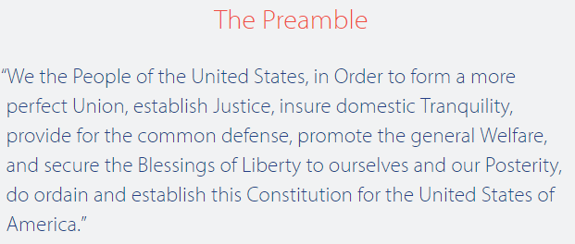
The Constitution - Articles
Article I – Article III – the branches of government are outlined
Article IV – relations among states, Article V – Amending Constitution, Article VI – Supremacy of National Govt, Article VII – Ratification
Constitutional Amendments – Bill of Rights, 11 - 27

