Slide 1
Events leading up to the American Civil War
12/14/16

Slide 2
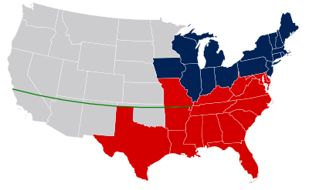
Missouri Compromise (1820)
Dealt with the expansion of slavery
Keep a balance between free and slave states
Missouri admitted as slave state and Maine would be a free state
36*30 Parallel would divide North and South (no slavery north of this line)

Slide 3
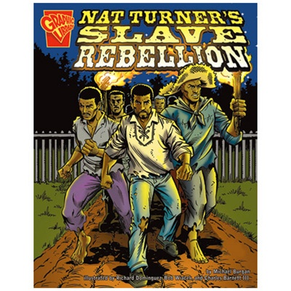
Nat Turner Rebellion (1831)
Nat Turner (slave) leader of slave rebellion
Killed around 60 white people in Virginia
Rebellion stopped after 2 days
Turner and 54 other slaves tried and executed
Over 200 more slaves lynched

Slide 4
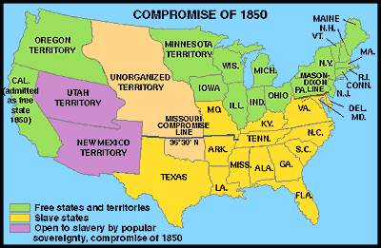
Compromise of 1850
California is admitted as a free state
No slavery restrictions in Utah and NM Territories
Fugitive Slave Act (Northerners must return runaway slaves to the South)

Slide 5
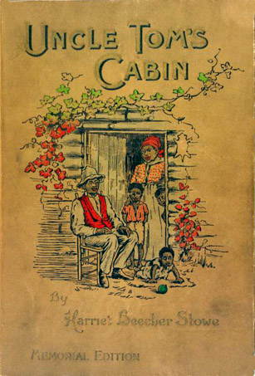
Uncle Tom’s Cabin (1852)
Novel by Harriet Beecher Stowe
Fictional story that detailed the horrors of slavery
Moved many northerners to want the abolishment of slavery
2nd best selling book of the 1800s (only behind the Bible)

Slide 6
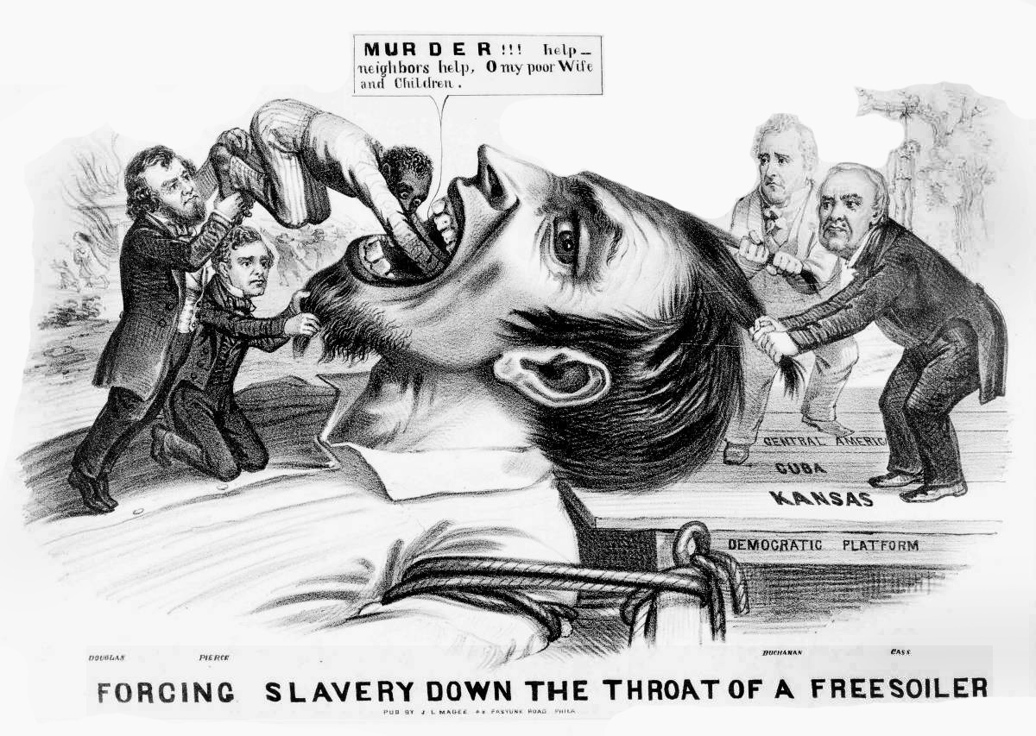
Bleeding Kansas (1854-1861)
Kansas-Nebraska Act of 1854
It is up to the state to decide if it was to be a free or slave state.
Pro slavery and anti slavery people fought over what the states would do
56 people killed over the slavery issue

Slide 7
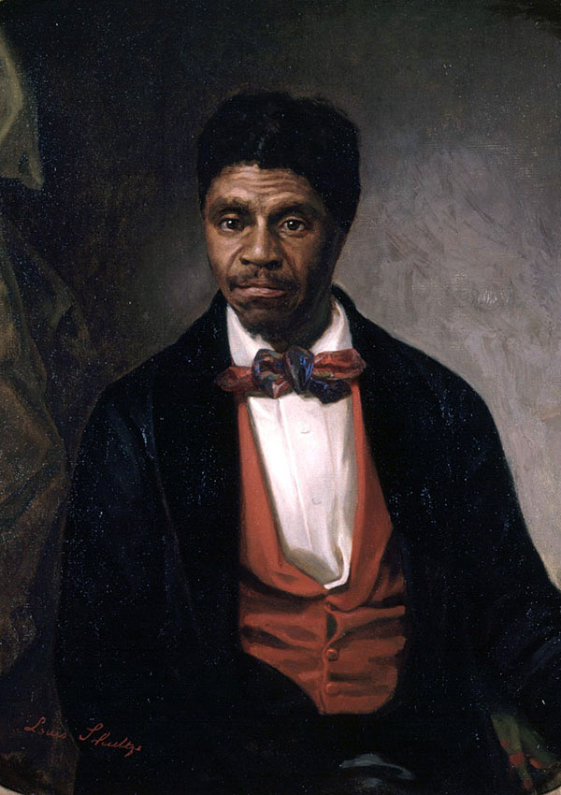
Dred Scott vs. Sanford (1857)
Dred Scott sued for his freedom
Supreme Court ruled against him
Supreme Court stated that Dred Scott was property and had no rights

Slide 8
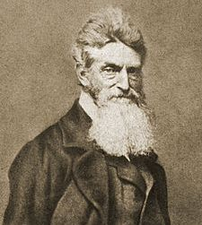
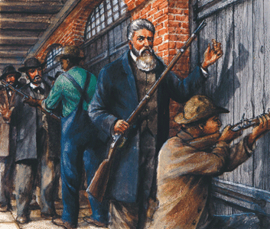
John Brown’s raid on Harpers Ferry (1859)
John Brown was extremely antislavery
Raids a federal arsenal to steal weapon
Wanted to give weapons to slaves to lead a rebellion
Stopped, captured and executed
Became a martyr

Slide 9
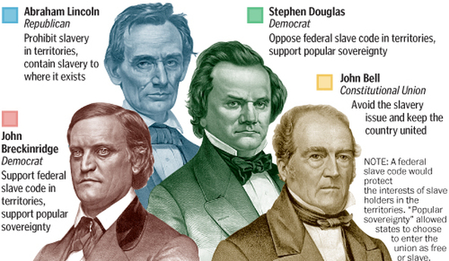
Abraham Lincoln elected President (1860)
Republican Abraham Lincoln wins presidency
Lincoln was not even on the ballot in many Southern states.
SC first state to secede from the Union

