Slide 1
Day 10 Vocabulary (set 3)
Great Awakening – religious revival movement that swept through the colonies in the 1730s-1740s bringing awareness of the importance of religion in people’s lives
Albany Plan of Union – proposal of one general government that would unite the colonies in order to defend themselves and set up a legislature
Pontiac’s Rebellion - Chief Pontiac attacked British forts on the frontier
Proclamation of 1763 – the temporary western boundary for the colonies drawn by King George III to prevent more fighting between French and Colonies /British

Slide 2
French and Indian War
CAUSES LEADING TO REVOLUTION

Slide 3
Background
Longstanding rivalry between France and England
War fought Europe from 1754 – 1763
Also known as the Seven Years War

Slide 4
Causes
Both France and Britain believed they alone had claim to a fertile stretch of land called the Ohio River Valley and Mississippi River Valley
France – connected New Orleans to colonies in Canada
Britain – needed land to expand their growing colonies in N. Amer.
English concerned about French forts being built by in the Ohio River Valley
Population of English colonies growing rapidly & pushing west

Slide 5
War Declared
George Washington leads surprise attack on Fort Duquesne and a counter attack was launched by French on Fort Necessity
George Washington retreats to VA
British send General Edward Braddock to drive out the French of the Ohio River Valley in 1755 (Newfoundland and Nova Scotia)
He is defeated by ambush, he was killed near Fort Duquesne (1755)
War is officially declared in 1756 (British on France)
William Pitt – GB Secretary of State – transforms war, spends tons of $$$ into war HUGE DEBT
British Victories – Fort Duquesne, Fort Ticonderoga, Fort Louisbourg, Montreal

Slide 6
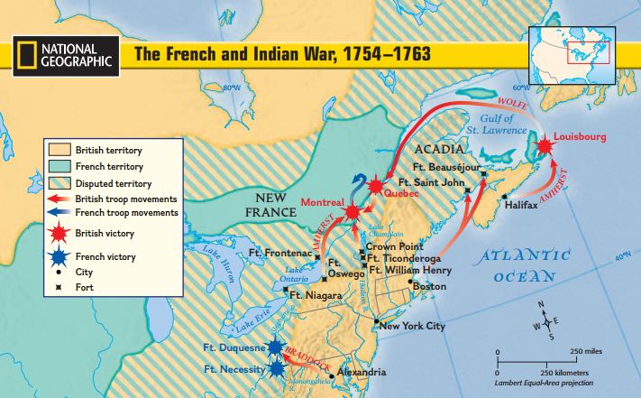

Slide 7
Treaty of Paris
After the fall of Quebec and capture of Montreal, the French and Indian War comes to an end.
France keeps some sugar producing islands in West Indians, has to give up Canada and most land east of Mississippi River to Great Britain
Spain gains French land west of Mississippi River (Louisiana Territory); Spain (who was France’s ally), GB gained Florida
Great Britain gains Canada and Florida

Slide 8
British interaction with Native Americans
Native Americans lost French allies and trading partners
British colonists are moving into land in west PA
Pontiac’s Rebellion (1763)– raids made on British around Great Lakes
Proclamation of 1763 was drawn up in order to prevent more fighting between the Native Americans by restricting westward expansion beyond the Appalachian Mtns.
Colonists were angered and this created tension between Colonists and British.

