Slide 1
Thomas Jefferson

Slide 3
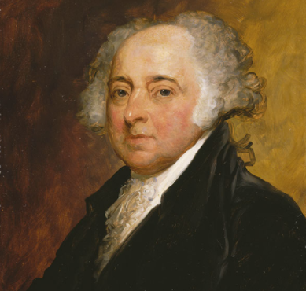
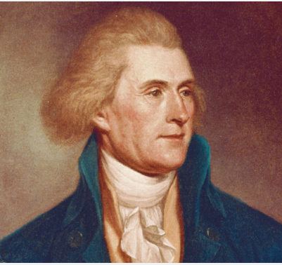
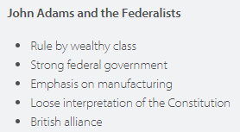
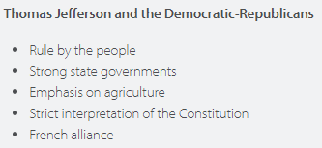
Election of 1800
Peaceful change of political power from one party to another
The tied race led to 12th amendment which created a separate ballot for president and vice president

Slide 4
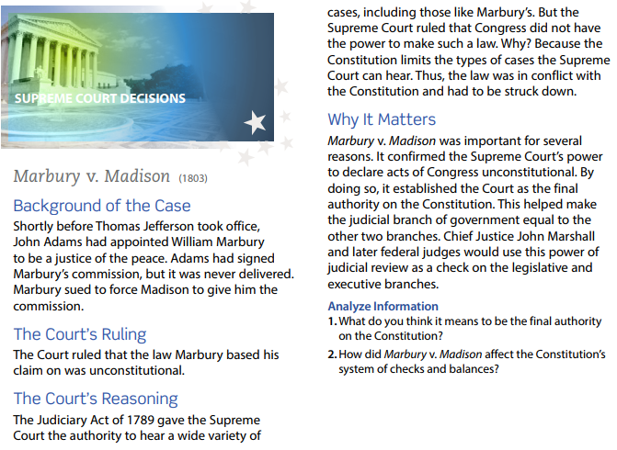

Slide 5
Marbury v. Madison
Judiciary Act of 1801 – created 16 new federal judgeships that Adams filled with Federalists right before leaving office (Judges referred to as Midnight judges)
John Marshall – federalist that was appointed by J. Adams, Jefferson and Marshall disagreed on many issues
Marbury v. Madison – helped establish the supreme court’s power to check the power of the other branches of government
Judicial review – power to declare an act of Congress unconstitutional

Slide 6
Louisiana Purchase
Goal of Jefferson is to expand the borders of the United States
Problem – no ports on Gulf of Mexico (controlled by France)
James Monroe is sent to negotiate the port with France
French offer to sell the entire Louisiana Territory to the US for just $15 Million
Louisiana Purchase – finalized in 1803, would double the size of the US

Slide 7
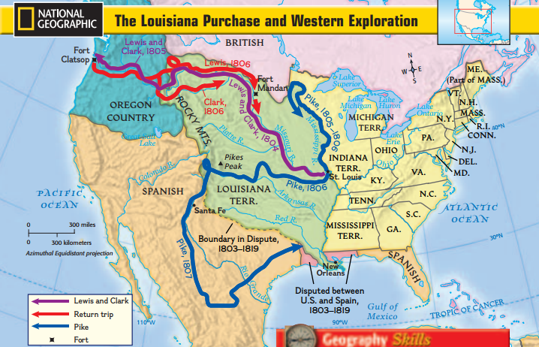

Slide 8
Lewis and Clark
Merriwether Lewis (Jefferson’s private secretary) and William Clark – led journey of exploration west (1804 Spring)
Left St. Louis worked its way up the Missouri River
Kept a journal of their voyage and all they encountered
Plants, people, animals, and the geography of the west
Sacagawea – Shoshone woman that joined their group as a guide
Reach Pacific Ocean, turned around and returned in 1806
Brought an inspiration for people to move westward
Manifest Destiny – belief shared by Americans that the United States should expand across the continent to the Pacific Ocean “Our god given right”

Slide 9
Madison, Monroe, and Quincy Adams
12/12/17

Slide 10
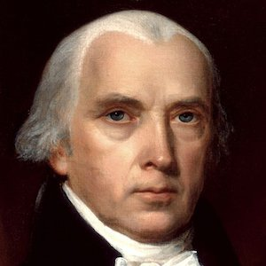
James Madison (Background information)
4th President (1809-1817)
“Father of the Constitution”
From Virginia
He was the last living signer of the Constitution

Slide 11
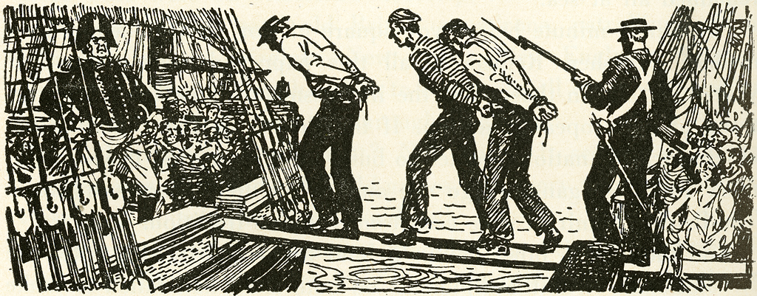
War of 1812 (the Second War for Independence)
Causes:
Impressment (kidnapping American sailors and forcing them into the British Navy)
British hindering U.S. trade
British helping American Indians attack US

Slide 12
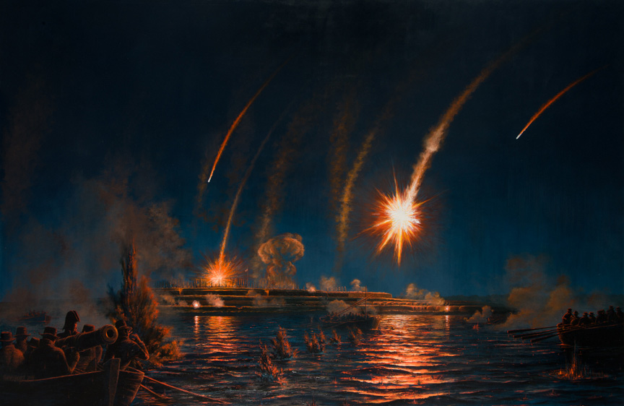
Most important results of the War of 1812
1. Star Spangled Banner written by Francis Scott Key after the Battle for Fort McHenry
2. The British captured Washington D.C. on August 24, 1814 and burned the Capitol and the White House
3. Dolly Madison saves the painting of George Washington
4. Andrew Jackson becomes a war hero after the Battle of New Orleans.

Slide 13
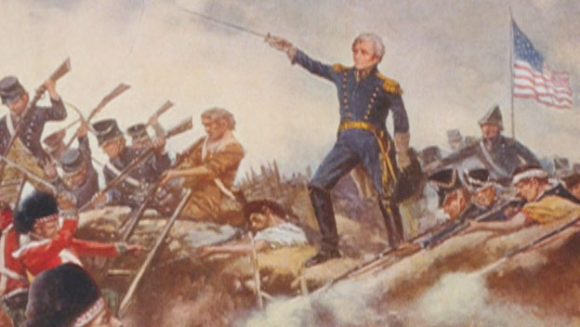
War of 1812
Ended in a tie (deadlock/stalemate)
Treaty of Ghent officially ended the war
No borders or land changed

Slide 14
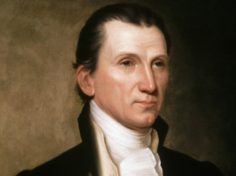
James Monroe
President from 1817-1825
From Virginia
Last of the “Founding Fathers” to become President
Purchased Florida from Spain
Most remembered for the Monroe Doctrine
Died on July 4, 1831

Slide 15
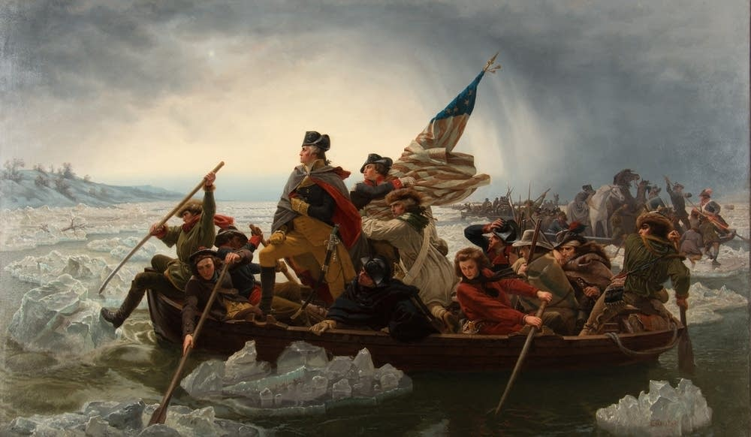
James Monroe was wounded at the Battle of Trenton. Did you know that James Monroe is in this Picture? Which soldier do you think is him?

Slide 16
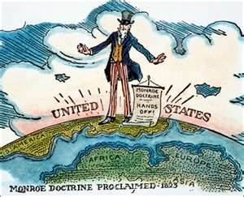
Monroe Doctrine
Proclamation in 1823 by President James Monroe. Basically, it warned European nations not to get involved in political matters in Central and South America. The Doctrine was intended to show that the United States was the only country that could influence such political matters.

Slide 17
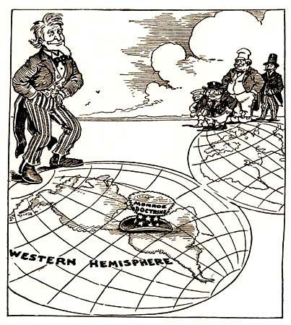
Simplest Definition of the Monroe doctrine
Europe, stay out of the Americas!

Slide 18
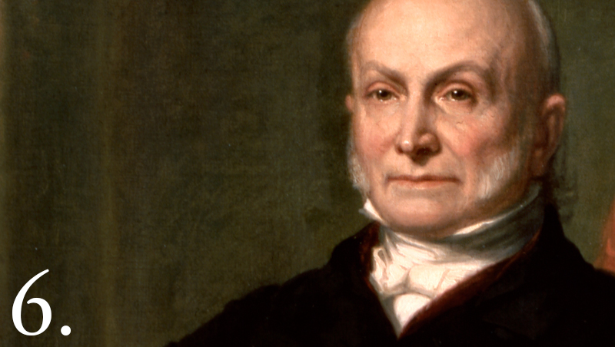
John Quincy Adams
President from 1825-1829
Son of John Adams (2nd President)
First father and son to both be president
Strong abolitionist
Lost the election of 1828 to Jackson
Elected as a representative to the House of Rep. from Mass.

Slide 19
Corrupt Bargain of 1824
Candidate Electoral Votes Popular Vote
A. Jackson 99 153,544
J.Q. Adams 84 108,740
W. Crawford 41 40,856
H. Clay 37 47,531
Why would people say that John Quincy Adams becoming the sixth President of the United States was corrupt?

