Slide 1
Why did the Confederation Congress call for the Constitutional Convention?
How did the Constitutional Convention compromise on the issue of slavery?
Notes:
🍐 This is a Pear Deck Text Slide.

Slide 2
New System of Government

Slide 3
Draw or type 2 things that you already know about the new government:
Notes:
🍐 This is a Pear Deck Drawing Slide.

Slide 4
The New Government
Most wanted a stronger Central Govt, but wanted to protect the individual rights – supporting Dec of Ind.
Popular sovereignty – the idea that political authority belongs in the hands of the people
Republic – representative democracy, government consists of people elected by voters to represent them

Slide 5
Branches of Government
Divided power of the central government among 3 branches of govt, each having specific roles – Separation of Powers
Legislative Branch – Congress; bicameral (2 houses) – House of Representatives and Senate
Propose and pass laws
Executive Branch – president and departments that help run the govt
Makes sure laws are carried out
Judicial Branch – all national courts
Interprets laws and punishes criminals and settles disputes b/w states
Checks and Balances – system that prevents any branch from becoming too powerful
Why did they create checks and balances?
Notes:
🍐 This is a Pear Deck Text Slide
🍐 To edit the type of question, go back to the "Ask Students a Question" in the Pear Deck sidebar.

Slide 6
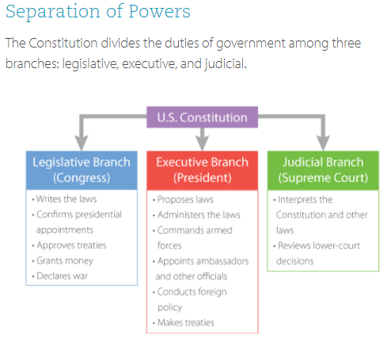
Whose job is to declare war?
Whose job is to interpret the Constitution?
Notes:
🍐 This is a Pear Deck Text Slide
🍐 To edit the type of question, go back to the "Ask Students a Question" in the Pear Deck sidebar.

Slide 7
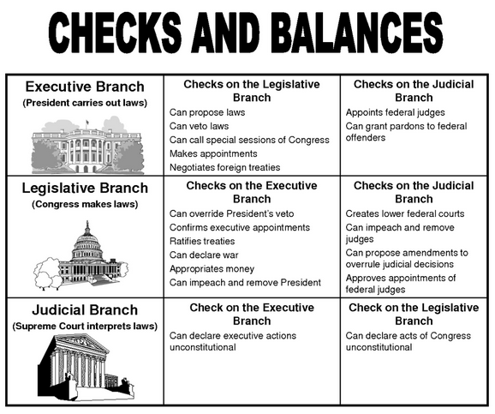
In what ways does the Legislative Branch make sure the President doesn’t have too much power?
Notes:
🍐 This is a Pear Deck Text Slide
🍐 To edit the type of question, go back to the "Ask Students a Question" in the Pear Deck sidebar.

Slide 8
The Constitution Strengthens the National Government

Slide 9
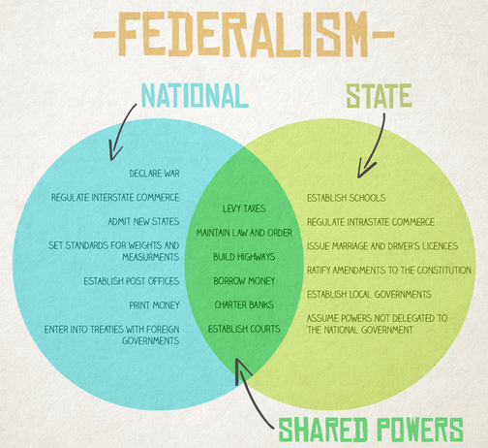
Federalism
Federalism – system of government where power is distributed between central government and state governments
Why does the power to declare war belong only to the National government?
Notes:
🍐 This is a Pear Deck Text Slide
🍐 To edit the type of question, go back to the "Ask Students a Question" in the Pear Deck sidebar.

