Slide 1
1. What did the Mayflower Compact and the Fundamental Orders of Connecticut have in common? 2. What freedom did Rhode Island offer that other colonies did not?
CREATE A GOOGLE DOCS
WARM UP

Slide 2
The Middle and Southern Colonies

Slide 3
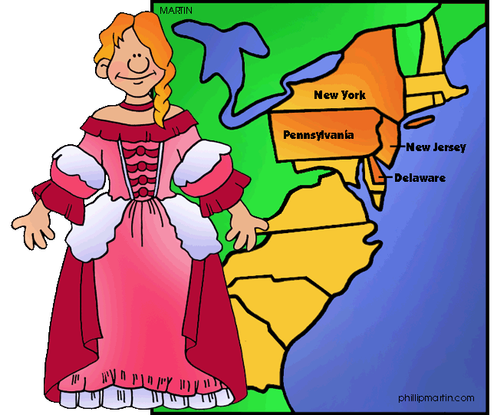
Middle Colonies Most diverse population in Colonial America

Slide 4
Key Terms
patroons
proprietary colony
pacifist
Wealthy landowners in New Netherland colony who brought at least 50 settlers to work the land given by the Dutch West India Company
Colony in which the owner, “proprietor” owned all the land and controlled the government too.
Person who refuses to use force or to fight in wars

Slide 5
England and the Colonies
Oliver Cromwell, a Puritan who led the Parliamentary forces to defeat King Charles I in a civil war in England.
Charles I was beheaded after he was declared guilty of treason
After the war ended, English men and women loyal to the king went to royal colonies like Virginia.
1660, England, known as “Restoration” Charles II restored the monarchy
2 clusters of colonies: New England – and Virginia and Maryland in the south
Between is colonial land controlled by Dutch
1621 Dutch merchants formed Dutch West India Company to trade

Slide 6
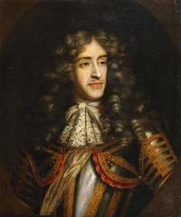
New Netherland (a.k.a. New York)
Bought from Manhates for beads and other goods (New Amsterdam, located on Manhattan Island)
Became good seaport to and from Americas, soon families were sent over from Netherlands, Germany, Sweden and Finland.
Dutch West India Company gave a large estate to anyone who brought at least 50 settlers to work the land ← the wealthy landowners giving the land away are called patroons, and ruled like kings
English wanted this great land that would connect the 2 groups of colonies, and sent a fleet in 1664 to attack New Amsterdam
New Amsterdam had to surrender, unprepared under P. Stuyvesant, and the land was given to King Charles II brother, the Duke of York, renaming it New York.

Slide 7
New York
Proprietary colony, the owner, owned all the land and controlled the government
Different from N.E. Colonies where voters elected the governor and an assembly
Most settlers lived in the Hudson River Valley
Duke of York promised freedom of religion and to keep their property – resulting in most Dutch colonists to remain in NY.
By 1683 population grew from 8,000 to 12,000; and in 1691, English government allowed NY to elect a legislature, making it a representative government

Slide 8
New Jersey
Duke of York gave southern part of his colony to Lord John Berkeley and Sir George Carteret, naming it New Jersey (after English island)
To attract settlers, proprietors offered:
large tracts of land
promised freedom of religion,
trial by jury,
and a representative assembly
Didn’t have success in profits because of the lack of natural harbors, and was sold (east and west) and became a royal colony because it was passed back in the hands of the king in 1702

Slide 9
Pennsylvania
William Penn, requested land from King Charles, from a loan Penn’s father lent the king.
The tract of land stretched inland from the Delaware River, Pennsylvania
Penn belonged to the Quakers, a dissenter group of the Protestants, that believed every individual had an “inner light” that could guide them to salvation – they believed everyone was equal in God’s sight, were tolerant of other views, but firm
Quakers were seen as a threat to England’s established traditions, many were fined, jailed, and executed
They were also pacifists, refusing to fight in wars or use force

Slide 10
Holy Experiment
Penn wanted to put the Quaker Ideals into practice, supervising the building of Philadelphia “the city of brotherly love”
Several treaties between Native Americans regarding land, he felt settlers should pay N. Amer for land - FAIR
Pamphlets were created and distributed to attract settlers- multiple languages
1701 Charter of Liberties, colonists are given the right to elect representatives to legislative assembly
Charter of Privileges allowed the Three Lower Counties (south PA) to form own legislature, becoming Delaware
Philadelphia

Slide 11
Complete the following chart
COLONY | FOUNDER | WHY SETTLERS CAME
NEW YORK
NEW JERSEY
PENNSYLVANIA

Slide 12
Answer the following questions
1.What did the Charter of Liberties grant to Pennsylvania colonists?
2.How was the Quaker Religion different from that of the Puritans?
3.Match the following:
1. Charles II brother a. Quakers
2. colony of New Netherland b. Philadelphia
3. wealthy landowners c. Duke of York
4. Society of Friends d. New Amsterdam
5. “city of brotherly love” e. patroons

Slide 13
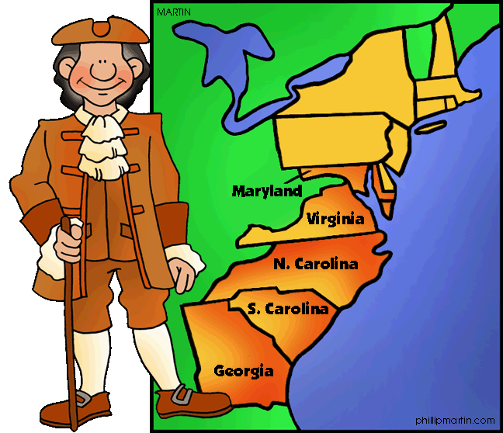
Southern Colonies

Slide 14
Key Terms
Indentured servant
constitution
debtor
A person that agrees to work for free for a certain amount of time in return, a passage to the Americas
A plan of government.
Person unable to repay the money owed
Tenant farmer
mission
Farmer who pays his lord, the landowner, a yearly rent and works for him a certain number of days each year.
Religious settlement established to convert people to a particular faith
Estate
Pieces of land

Slide 15
Maryland
Dream of Sir George Calvert, Lord Baltimore, but his son had to fulfil because LB died.
Cecilius named the colony he inherited Maryland and arrived in 1634
Gave large estates to English aristocrats
Due to large land, large number of enslaved Africans and indentured servants were needed to help on the land and were imported
Calvert and Penn argued over the boundary between Maryland and Pennsylvania, so they hired Charles Mason and Jeremiah Dixon to map out the boundary and lay stones with the Penn and Calvert crests – Mason-Dixon line.
Calvert welcomed Protestants and Catholics in MD, in order to protect the outnumbered Catholics, the Act of Toleration was passed in 1649 – granting both groups to worship freely. Anglican church became official church – restricting Catholics the same way they had in England

Slide 16
Virginia
Virginia continued to grow, settlers moving west and settling on Native American land
Bacon’s Rebellion – in 1640s VA Governor W. Berkeley pledged the Nat. Americans to keep settlers from pushing further west in exchange for a large piece of land.
Nathanial Bacon, planter in western VA opposed the government that was controlled by easterners and led attacks on Nat American villages in 1676. Marched his army to Jamestown and drove Berkeley into exile.
Bacon’s Rebellion showed settlers would not be limited to the coast. The Colonial government formed a militia to control Nat. Amer. and opened more land for settlement

Slide 17
Carolinas
King Charles II created a proprietary colony south of Virginia – Carolina “Charles Land” given to 8 nobles that helped him regain his throne.
Proprietors set up estates and sold/rented land to settlers brought from England.
John Locke, English philosopher, wrote a constitution (plan of government) for the colony that covered topics such as land division and social ranking.
Concerned with principles and rights – he argued “every man has a property in his own person…The labour of his body, and the work of his hands…are properly his”
North – grew tobacco and sold timber and tar, but lacked a good harbor, so used VA’s ports to conduct trade
South – fertile farmland, and harbor at Charles Town (Charleston) prospered, Settlements spread and trade in deerskin, lumber and beef thrived.
Rice and Indigo became large crops, needing more labor…more slaves

Slide 18
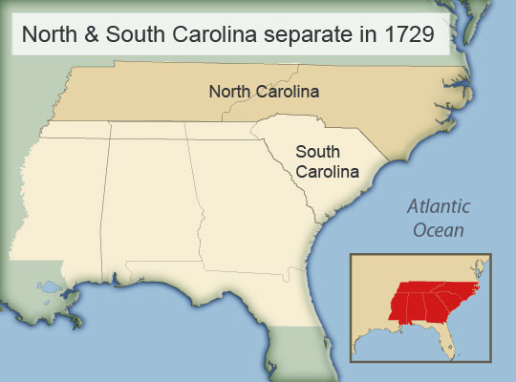
The Split
By early 1700s, Carolina’s settlers wanted political power
1719 settlers in southern Carolina seized control from its proprietors
1729 Carolina became 2 royal colonies – North Carolina and South Carolina

Slide 19
Georgia
Last of the British colonies to be established, in 1733.
James Oglethorpe, a general, received charter to start colony for debtors and poor people to make a fresh start.
They also wanted to protect the other British colonies from attack of Spain, Georgia could serve as the military barrier.
Built Savannah (Oglethorpe) as well as forts to protect themselves from Spanish.
Urged independence, hard work, Protestant faith.
Farms were small and banned slavery, Catholics and rum.
Less British came to settle – more were from Germany, Switzerland and Jewish
Oglethorpe was “dictator-style” and lifted ban on slavery, rum, and allowed larger land plots, and in 1751 gave up turning the colony over to the king.

Slide 20
Southern Colony Questions
Why did George Calvert want to establish a colony in America?
What did the colony do to supply laborers for the plantation fields?
Why did Nathaniel Bacon and his followers attack Jamestown?
Why was the southern part of Carolina more prosperous than the north?
Who was John Locke, what did he do for Carolina?
Why was the colony of Georgia established?
What are missions?

