Slide 1
Unit 10: Turbulent Decades
Visual Vocabulary

Slide 2
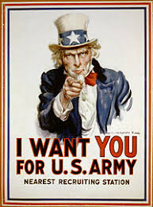
Turbulent Decades
Militarism
A build up of military strength with in a country.

Slide 3
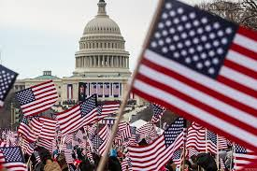
Turbulent Decades
Nationalism
Loyalty to a nation and promotion of its interests above all others.

Slide 4
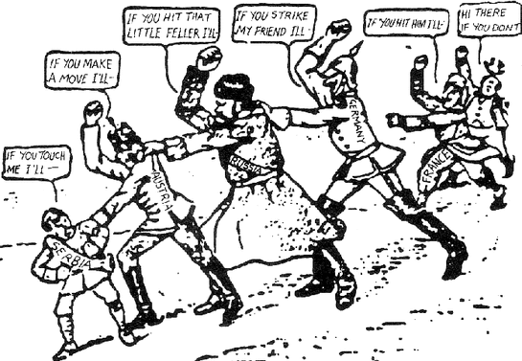
Turbulent Decades
Alliance System
Defense agreements amongst nations.

Slide 5
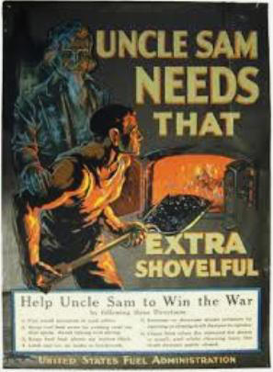
Turbulent Decades
Mobilization
Gathering resources and preparing for war.

Slide 6
Turbulent Decades
Red Scare
A period when the government went after Communists and others with radical views.

Slide 7
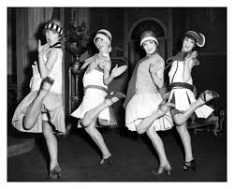
Turbulent Decades
Flappers
A young women of the 1920s who defied conventions in her behavior and dress.

Slide 8
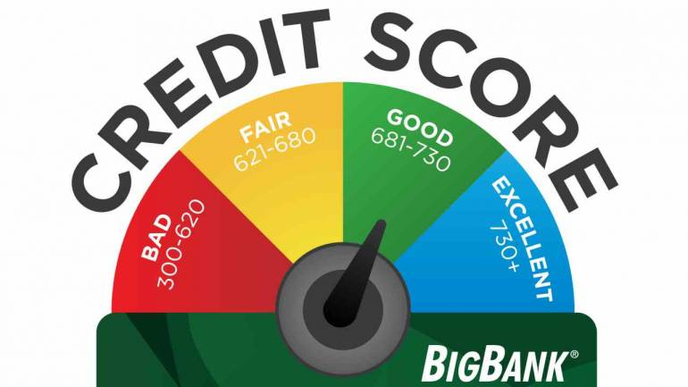
Turbulent Decades
Credit
A form of loan, ability to buy goods based on future payment.

Slide 9
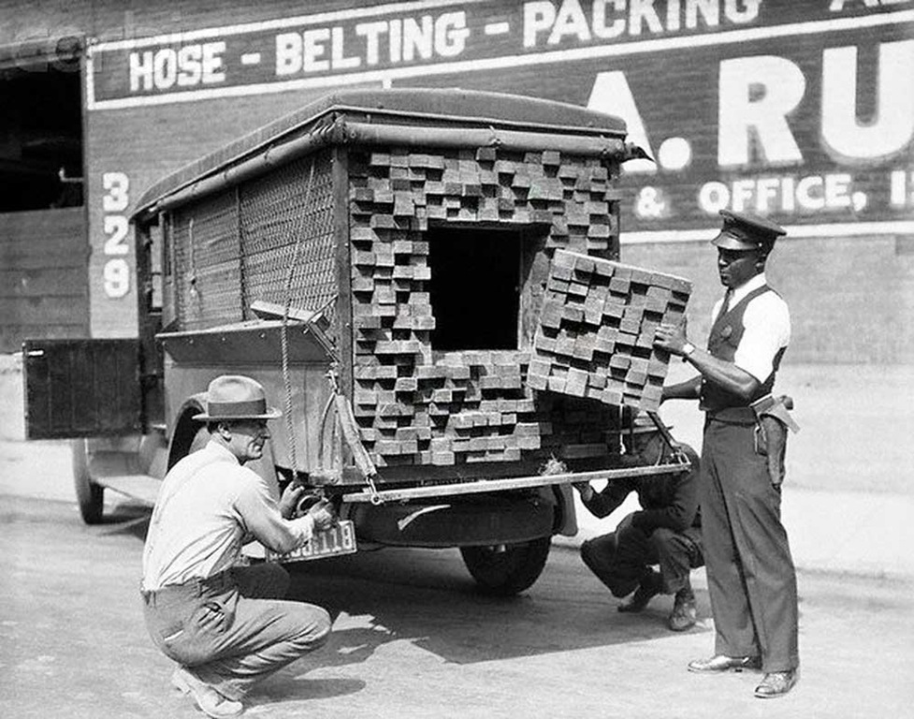
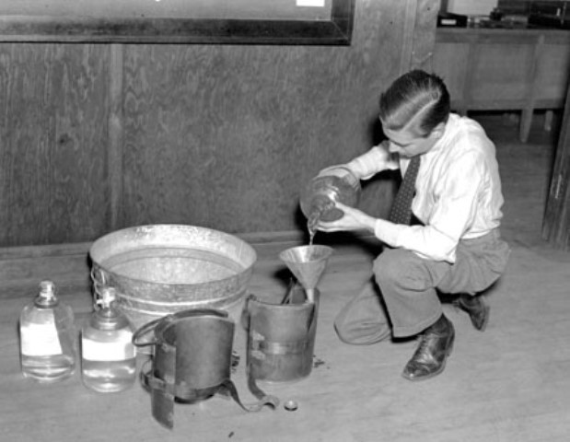
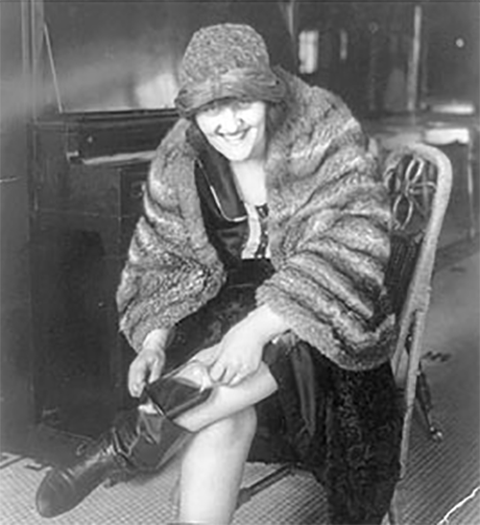
Turbulent Decades
Bootlegging
Making, selling, and transportation of illegal alcohol.

Slide 10
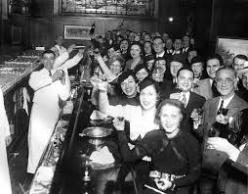
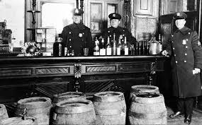
Turbulent Decades
Speakeasy
An illegal bar selling alcohol during the Prohibition period.

Slide 11
Turbulent Decades
On Margin
To buy stock by paying only a fraction of the stock price and borrowing the rest.

Slide 12
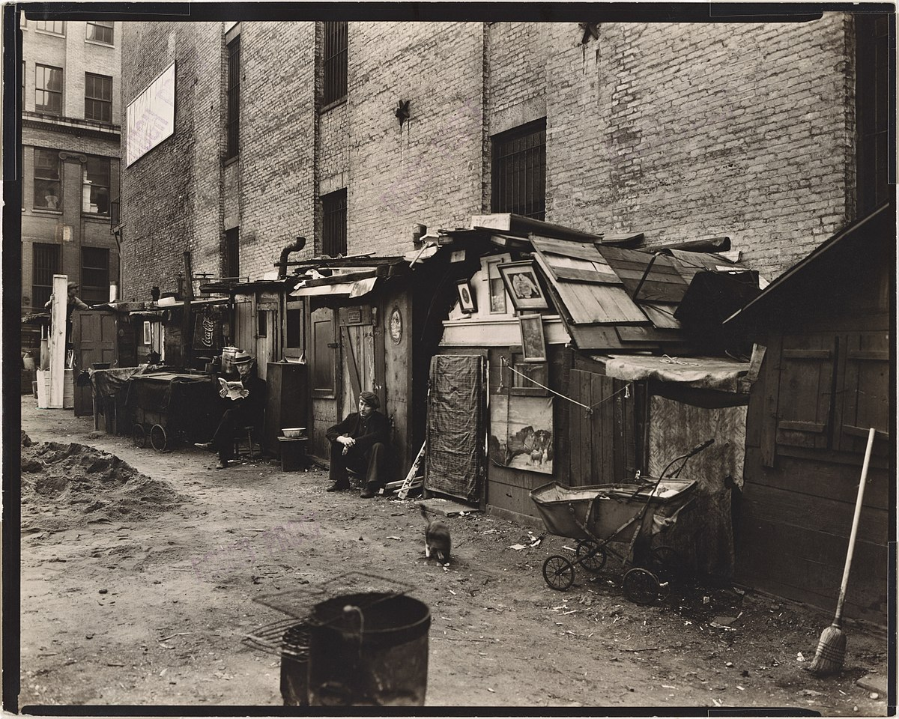
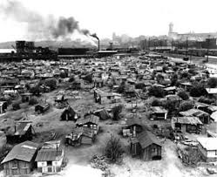
Turbulent Decades
Hooverville
a shantytown built by unemployed and poverty stricken people during the Depression.

Slide 13
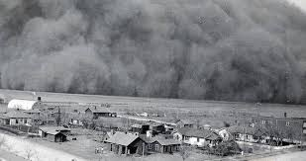
Turbulent Decades
Dust Bowl
Name given to the area of the Southern Great Plains severely damaged by droughts and dust storms during the 1930s.

Slide 14
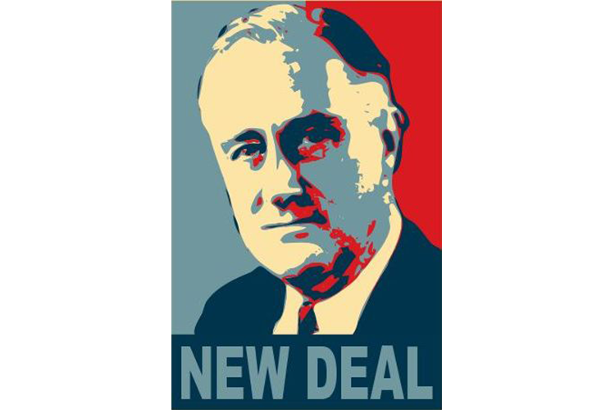
Turbulent Decades
New Deal
Name given to the new laws aimed at relieving the Depression.

Slide 15
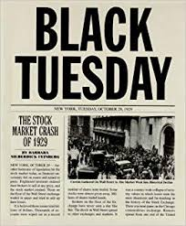
Turbulent Decades
Black Tuesday
Name given to stock market crash on October 29, 1929 plunging the US in to the Great Depression.

Slide 16
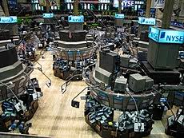
Turbulent Decades
Stock Exchange
A place where shares in corporations are bought and sold through an organized system.

Slide 17
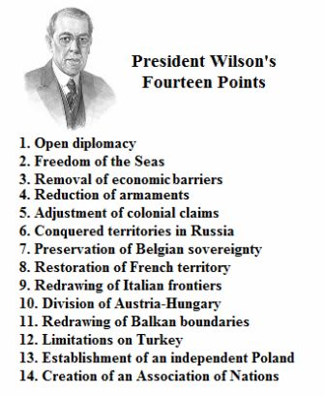
Turbulent Decades
Fourteen Points
The peace plan proposed by President Wilson to end World War I and restructure the counties of Europe.

Slide 18
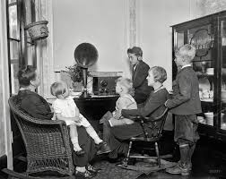
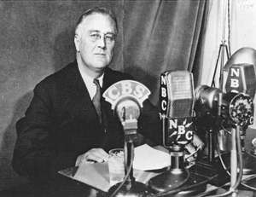
Turbulent Decades
Fireside Chats
series of radio broadcasts made by President Franklin D. Roosevelt to the nation, beginning in 1933 to describe his policies.

Slide 19
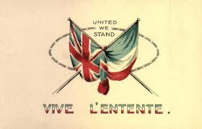
Turbulent Decades
Entente
An understanding between nations

Slide 20
Turbulent Decades
League of Nations
An association of countries to preserve peace and resolve international disputes proposed in the Fourteen Points.

Slide 21
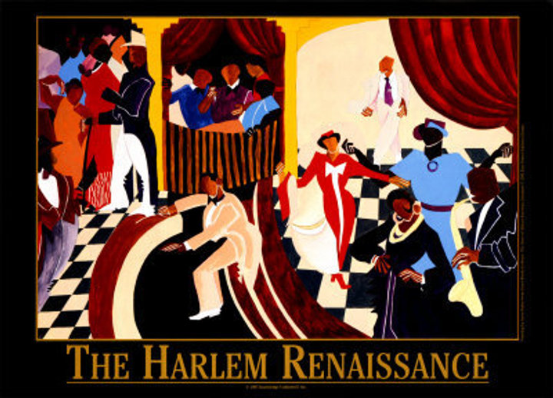
Turbulent Decades
Harlem Renaissance
A result of the Great Migration this part of New York City had a burst of creativity and flowering of African American culture.

