Slide 1
Warm-Up: Spiral Review-
What impact did propaganda have on the opinions of America in WWII? (Ex. Japanese Internment Camps)

Slide 2
World War II (1939-1945)
10-12 “War in the Pacific Theatre”

Slide 3
War in the Pacific and VICTORY
LESSON 6
Big Idea
Allied forces reversed Japan’s expansion in the Pacific and battled toward the main Japanese islands—all culminating in a victory for the Allied powers.
Main Ideas
The Japanese continued advancing across the Pacific in 1942.
The Allies stopped Japan’s advance with key victories over the Japanese navy.
The Allies began battling toward Japan.
The Allies gained victory in Europe with Germany’s surrender.
Victory in the Pacific came after the United States dropped atomic bombs on Japan.

Slide 4
Japan Advances
Main Idea 1
The Japanese continued advancing across the Pacific in 1942.
Attack on Pearl Harbor left U.S. Pacific fleet weakened.
Japan advanced and conquered Thailand, Burma, the British colonies of Hong Kong and Singapore, and the U.S. territories of Guam and Wake Island.
Japanese then attacked U.S. controlled Philippines.
American and Filipino forces under command of American general Douglas MacArthur
March 1942– Allied forces surrender Philippines to Japan.
Japanese march more than 70,000 captured soldiers to prison camps.
More than 600 Americans and 10,000 Filipinos died in the Bataan Death March.

Slide 5
Lesson 4
Key Allied Victories
Main Idea 2
The Allies stopped Japan’s advance with key victories over the Japanese navy.
Allies feared continued Japanese advance.
Americans were able to break Japanese codes and discovered battle plans.
American admiral Chester Nimitz led the U.S. Pacific Fleet in Allied response.
continued…

Slide 6
Key Victories in the Pacific
Battle of the Coral Sea
Japanese planned assault on Port Moresby, New Guinea.
American and Japanese aircraft carriers and fighter planes clashed.
No clear victor, but Japanese advance halted
Battle of Midway
Japanese planned surprise attack on Midway Islands.
June 4, 1942– Japanese attack and American fighters launch
American bombers destroy four carriers and severely weaken Japanese naval power.
Allied victory
Guadalcanal
Allies began recapturing Japanese territory.
August 1942– American Marines invade Guadalcanal.
Six months of intense fighting
February 1943– Allied victory

Slide 7
Battling Toward Japan
Main Idea 3
The Allies began battling toward Japan.
Allies went on offensive
Developed island hopping strategy, where Allied forces took only the most strategically important islands.
Won victories in Gilbert, Marshall, Mariana, Volcano, and Bonin Islands.
October 1944 – General MacArthur led mission to retake Philippines.
Confrontation at Battle of Leyte Gulf – largest naval battle in history
Allies crushed Japanese fleet.
Allied forces drove out all Japanese forces by summer 1945.
Allied planes began bombing targets in Japan.
Japanese refused to surrender.
continued…

Slide 8
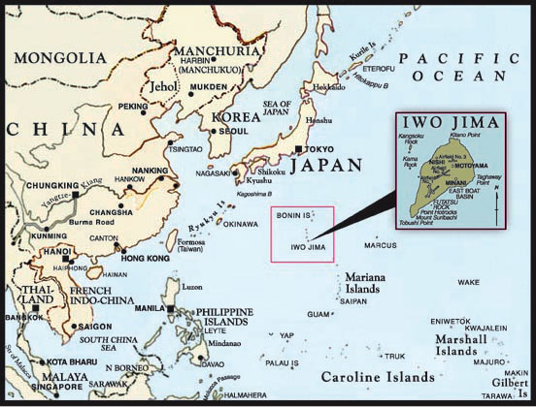
Final Battles
Iwo Jima
February 1945 – U.S. Marines stormed beaches of Iwo Jima
Month of bloody fighting
Of 20,000 Japanese defenders, about a thousand were taken prisoner, the rest were killed or wounded in battle.
Around 6,800 Americans killed
Okinawa
April 1945– U.S. forces attacked Okinawa.
Fighting lasted three months
Japanese planes used kamikaze tactic– purposely crashing piloted planes into enemy ships.
Severe casualties
Allies: 12,000 dead, 36,000 wounded
Japan: 110,00 troops and 80,000 civilians dead

Slide 9
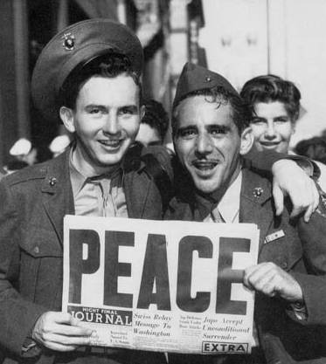
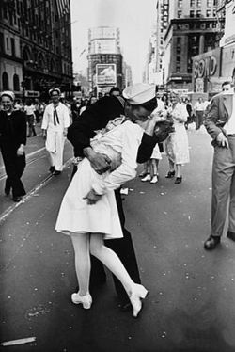
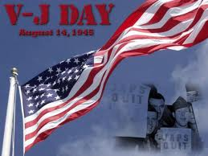
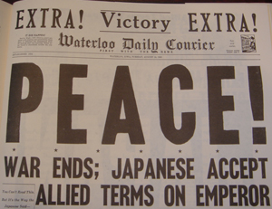
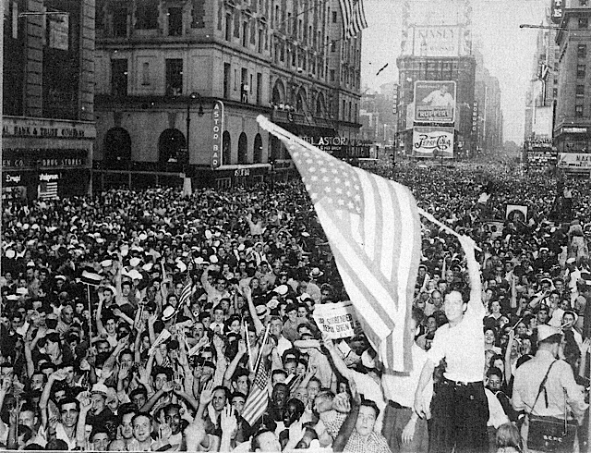
Germany Surrenders
Main Idea 4
The Allies gained victory in Europe with Germany’s surrender.
After D-Day invasion, hundreds of thousands of Allied troops land
Allies begin moving toward Germany.
July 1944 – Allied forces break western front.
August 1944 – Paris is liberated.
Allies push through Belgium and Luxembourg.
Germans plan last desperate attack at Battle of the Bulge, and lose.
continued…

Slide 10
Allied Push Toward Germany
January 1945 – Germans began to retreat.
Losses heavy – between 70,000 and 81,000 American casualties and even greater German loss
Allied bombing raids devastate major German cities.
April 1945 – Soviet troops enter Berlin.
April 12, 1945 – U.S. President Franklin D. Roosevelt dies of stroke.
May 8, 1945 – V-E (Victory in Europe) Day
New United States president Harry S. Truman faces challenge of winning war in Pacific.

Slide 11
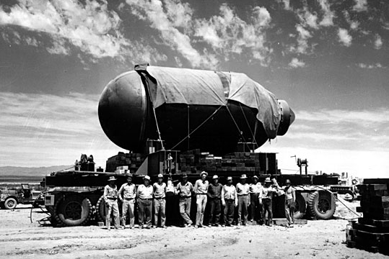
Lesson 5
Victory in the Pacific
Main Idea 5
Victory in the Pacific came after the United States dropped atomic bombs on Japan.
Allied scientists developed the atomic bomb, a weapon that produces tremendous power by splitting atoms, in a secret program known as the Manhattan Project.
When Japanese leaders refused to surrender, President Truman ordered use of the bomb.
August 6, 1945 – the B-29 bomber Enola Gay drops an atomic bomb, “Little Boy” on the city of Hiroshima.
Explosion killed almost 80,000 people instantly.
Thousands more died from burns and radiation poisoning.
Japanese leaders still refused to surrender.
continued…

Slide 12
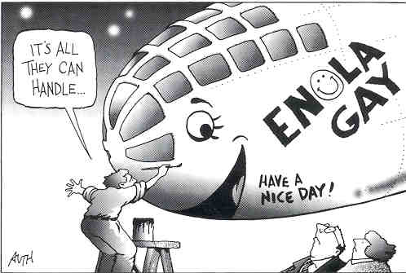
End of World War II
August 9, 1945 – U.S. forces drop a second atomic bomb, “Fat Man”, on city of Nagasaki.
One-third of the city destroyed
22,000 people killed instantly
August 15, 1945 – Japanese announce their surrender, known as V-J Day, thus ending World War II.
The war took a harsh toll.
50 million people killed
National economies in Europe and Asia devastated
Millions of people left without food, water, or shelter

Slide 13
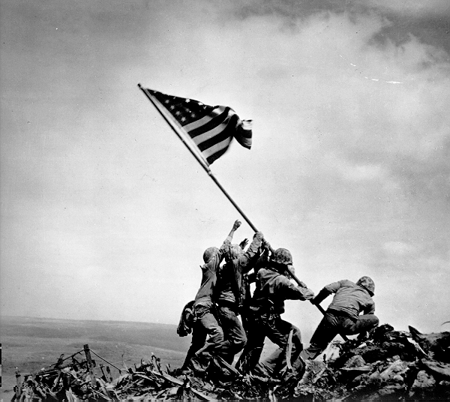

Slide 14
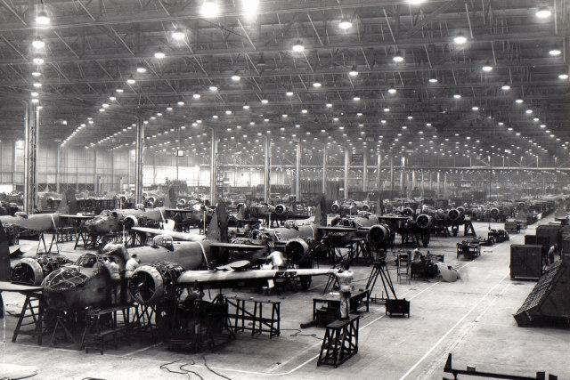
Exit Ticket
How did the war affect those who did not enlist in the military? Examples?

